Slide 1

Current research projects
Georg Gartner
Budapest 2016

Slide 2


Research Group Cartography
Current Thesis Work
Evaluating performance parameters for mouse/touch
Interactivity in map use context

Slide 3
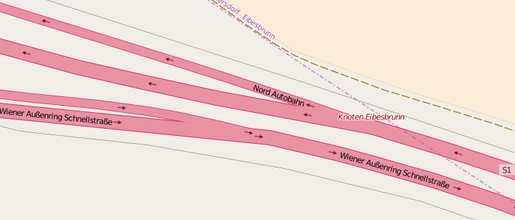
Research Group Cartography
Current Thesis Work
Deriving maps from OSM with meeting cartographic demands

Slide 4
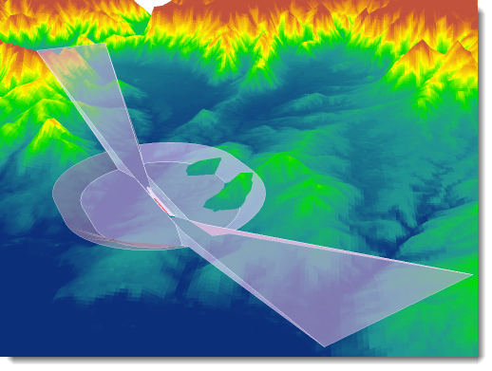
Research Group Cartography
Current Thesis Work
Evaluating OSS use for professional cartographic service
development

Slide 5
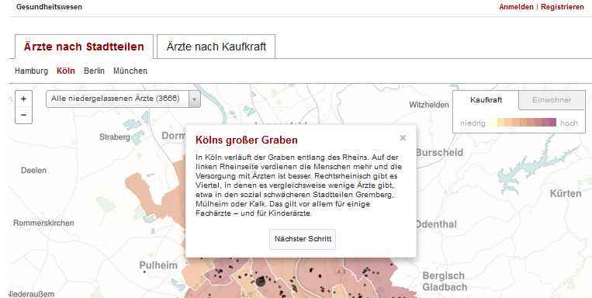
Research Group Cartography
Current Thesis Work
Supporting map interpretation by dedicated legends

Slide 6
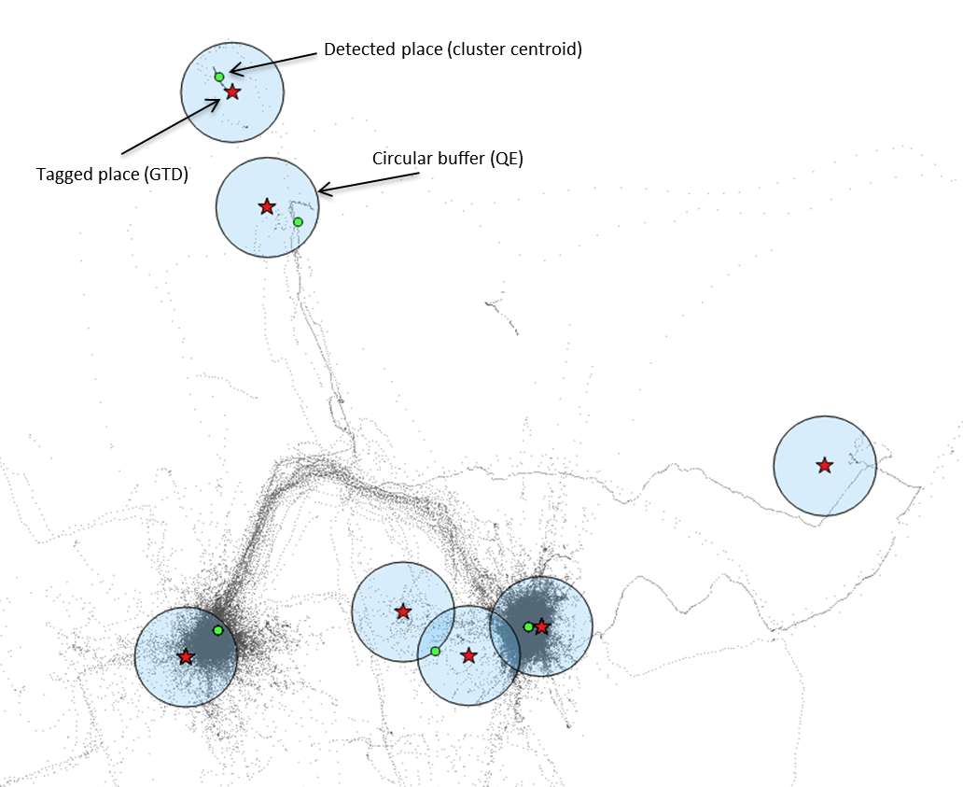
Research Group Cartography
Current Thesis Work
Extracting stops from GPS logs

Slide 7
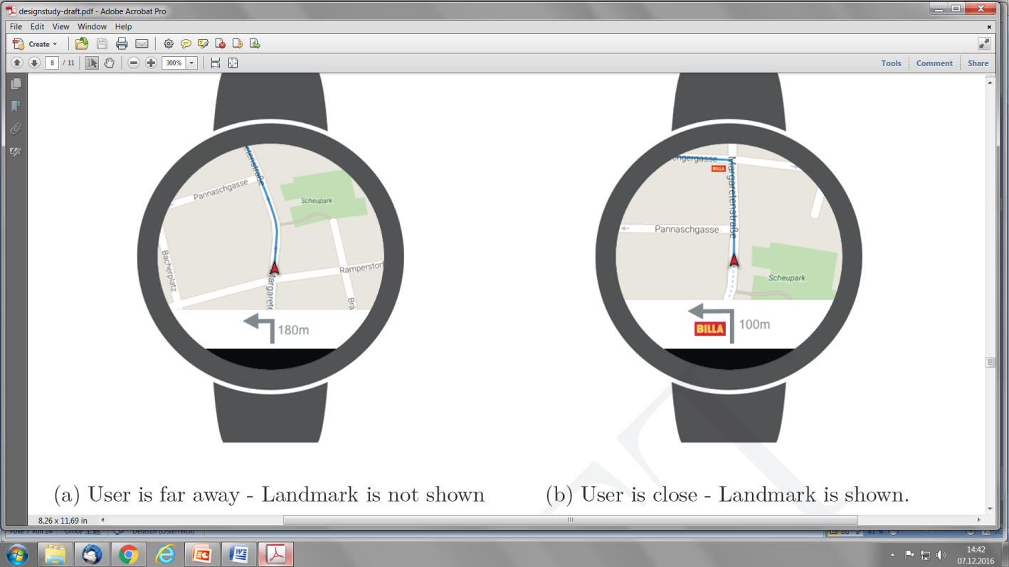
Research Group Cartography
Current Thesis Work
Smart watch pedestrian navigation

Slide 8
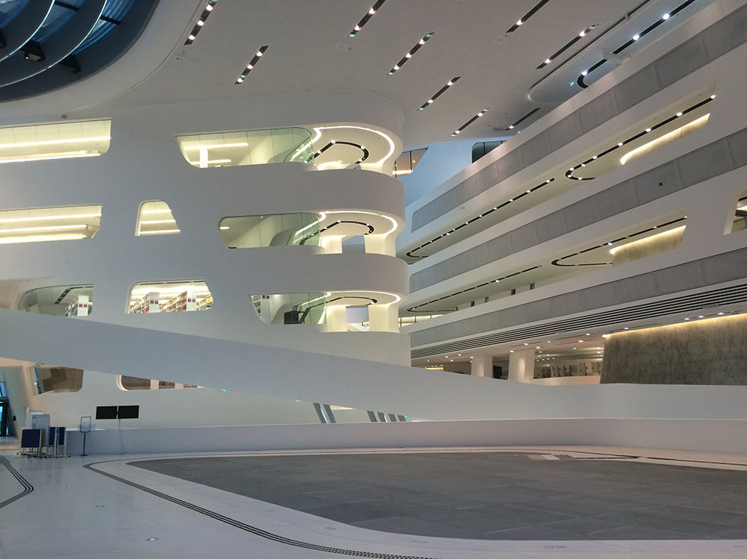
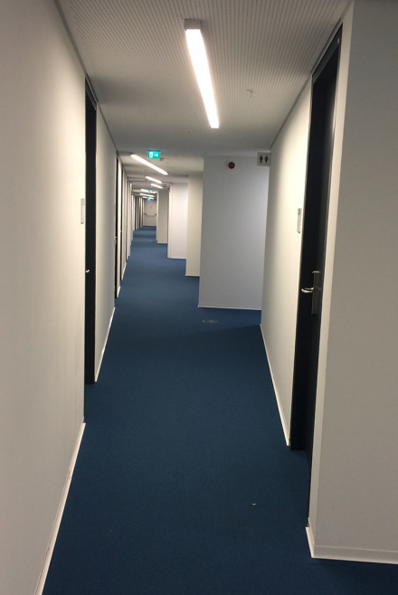
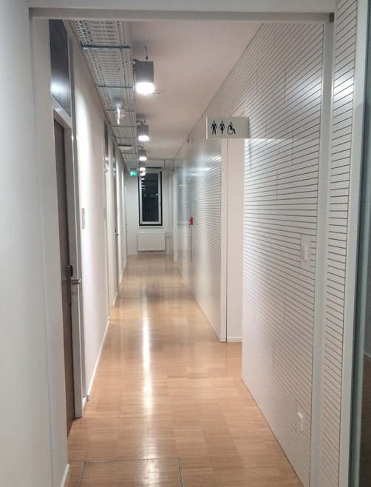
Research Group Cartography
Current Thesis Work
Deriving Indoor Navigation Instructions from BIM

Slide 9
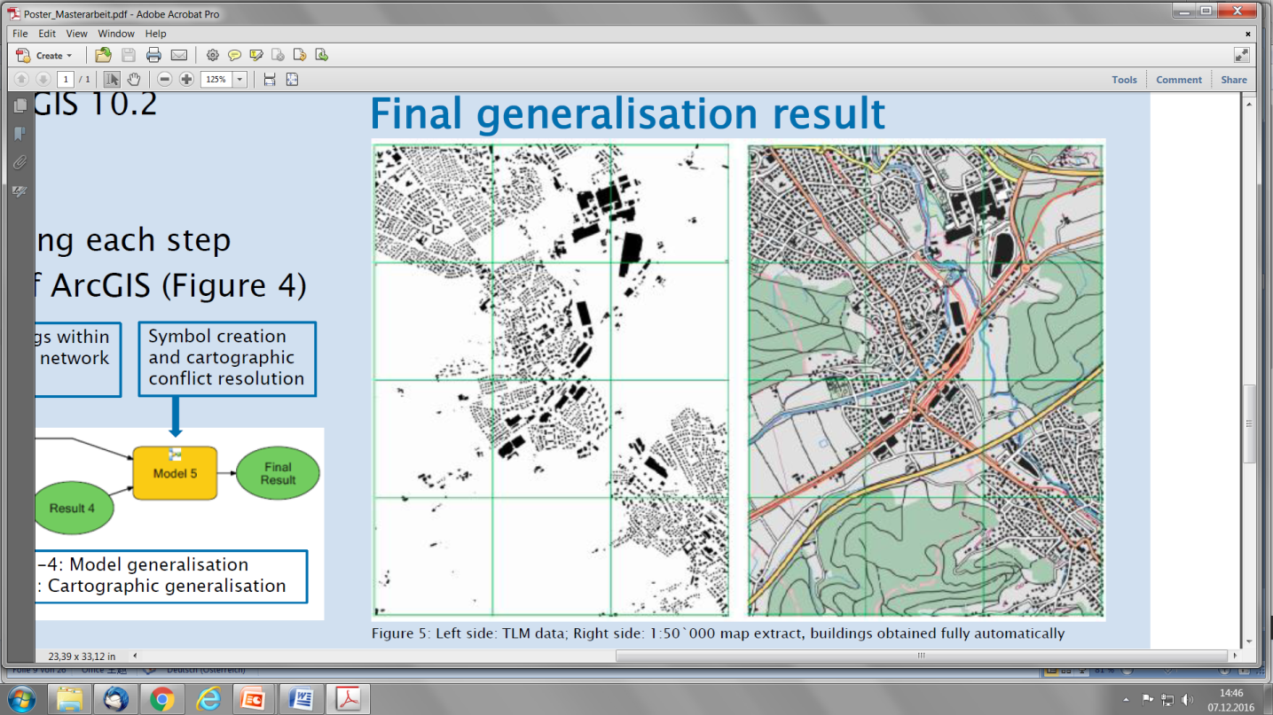
Research Group Cartography
Current Thesis Work
Cartographic Generalisation

Slide 10
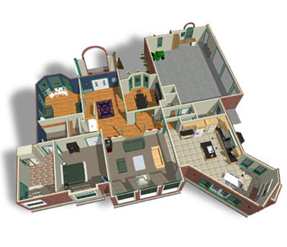
Research Group Cartography
Current Thesis Work
Improving Indoor Navigation by applying signage

Slide 11
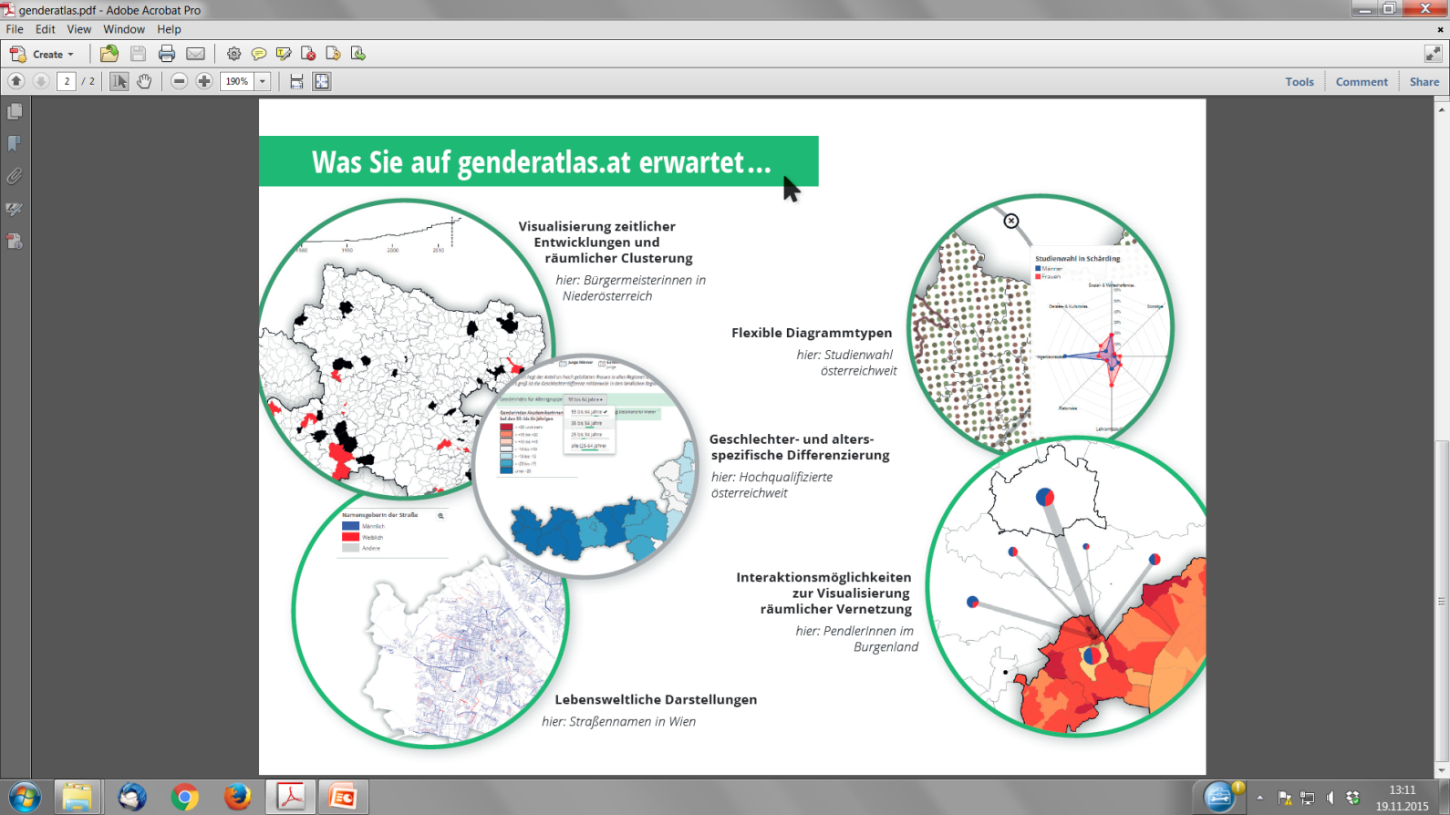
Research Group Cartography
Current Projects GenderAtlas
Genderatlas.at

Slide 12
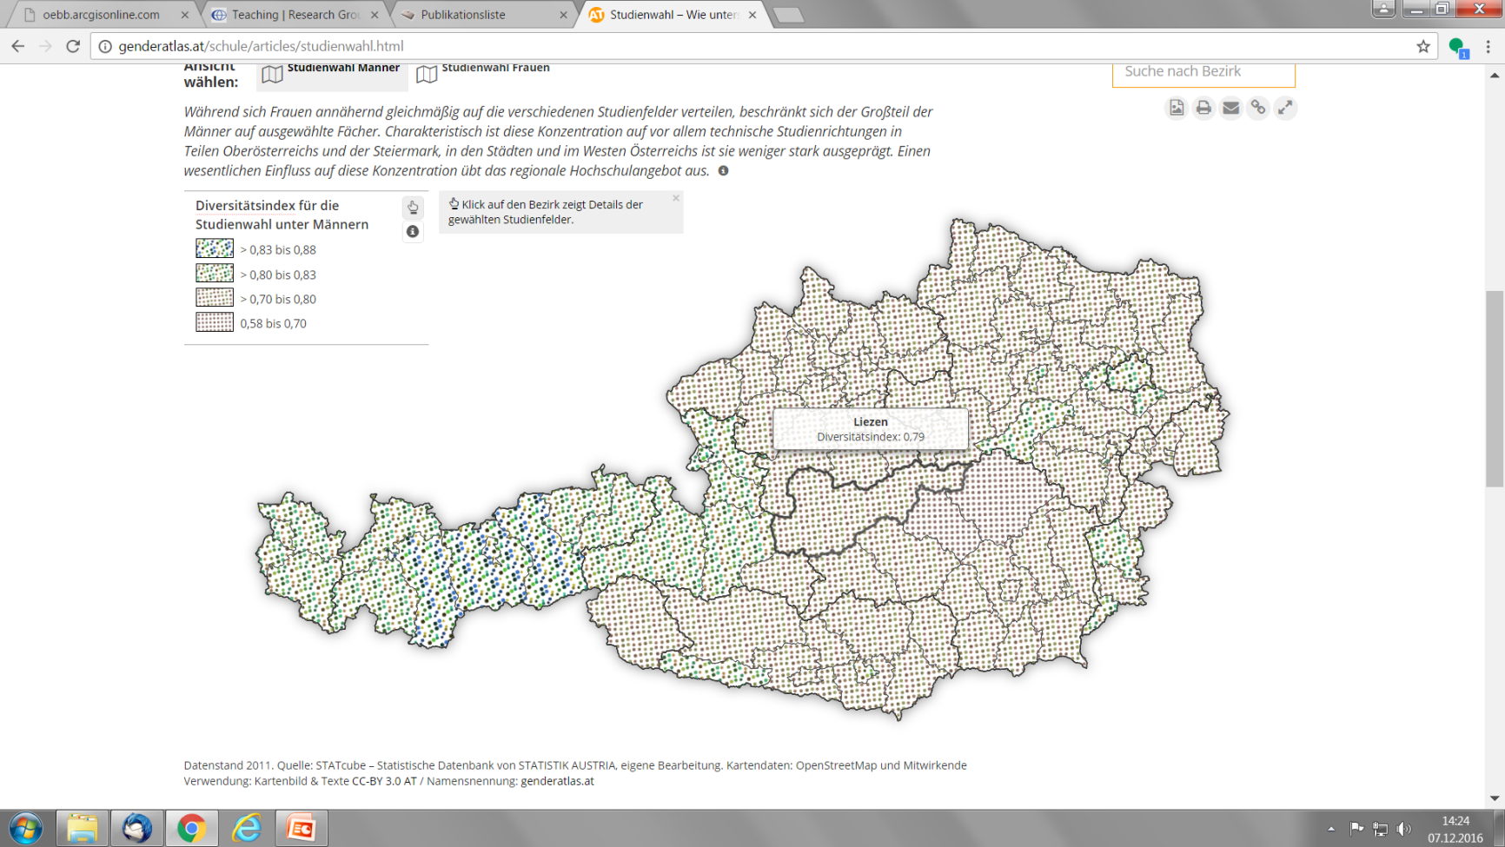
Research Group Cartography
Current Projects GenderAtlas for Schools

Slide 13

Research Group Cartography
Current Projects basemap.at

Slide 14
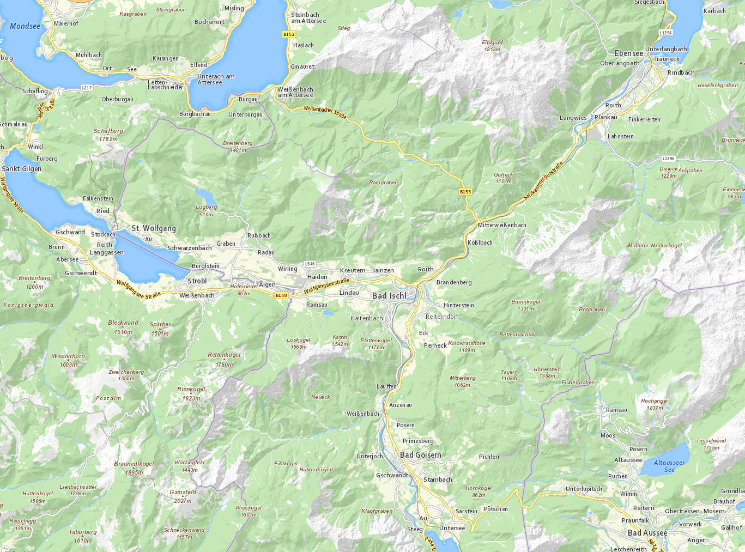

Slide 15
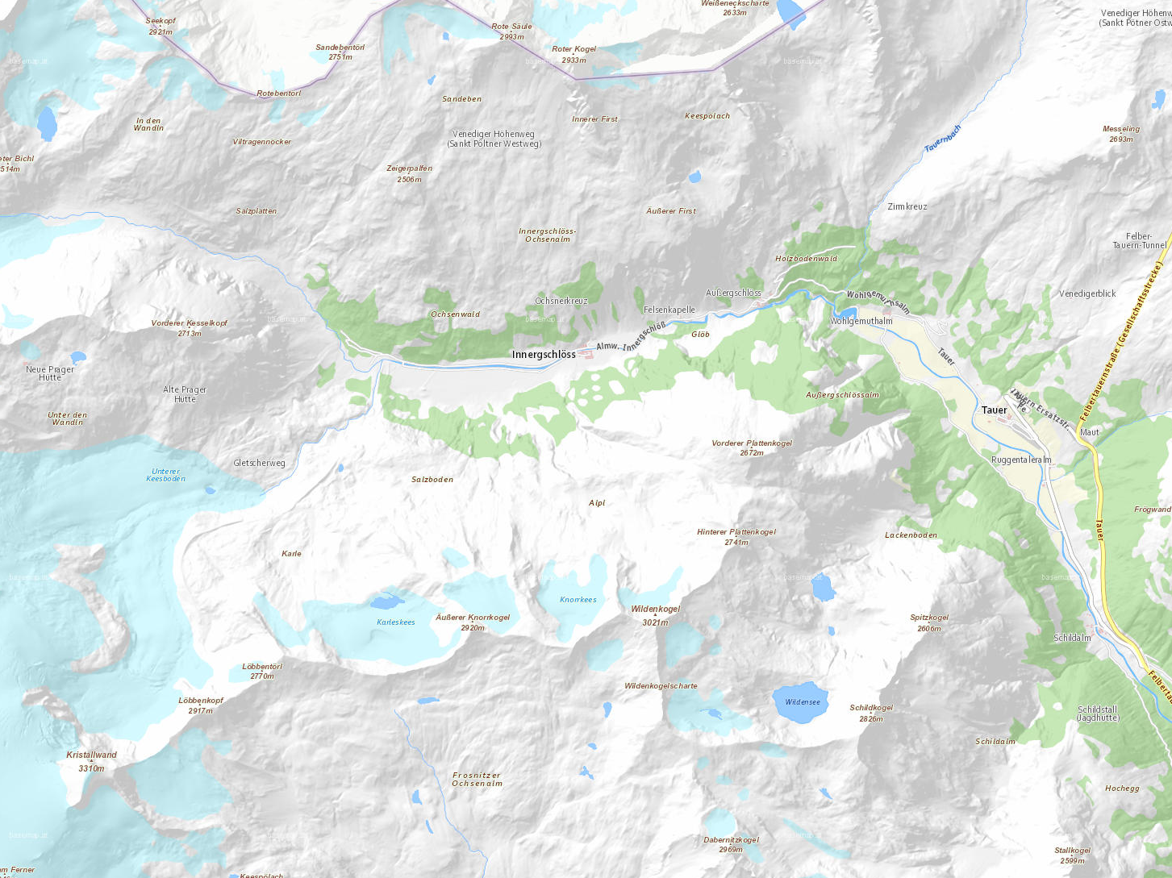

Slide 16
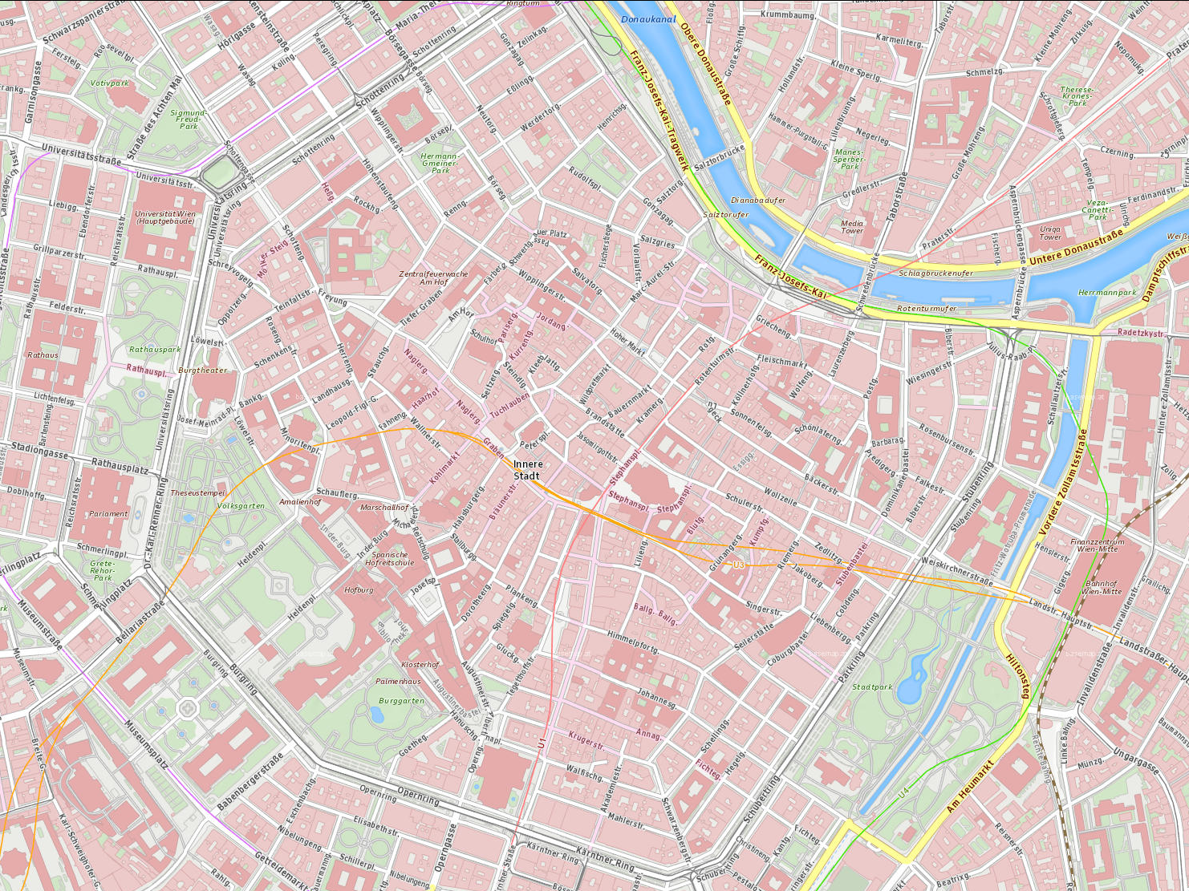

Slide 17
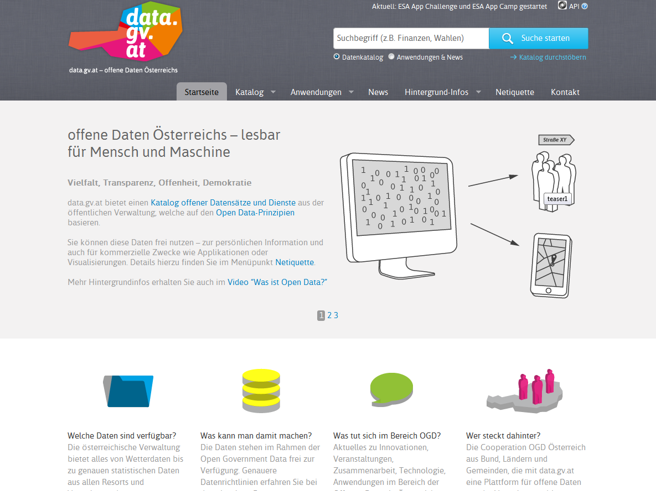

Winner - UN Public Service Award 2014
CMG-AE Tagung „Open Data, PSI, INSPIRE“
Notes:
data.gv.at hat im Juni 2014 den UN Public Service Award 2014 gewonnen

Slide 18
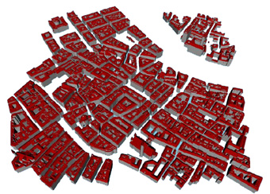

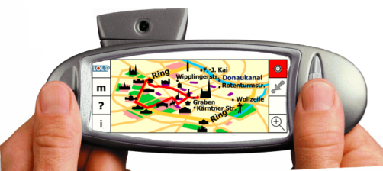
Research Group Cartography
Current Projects Context-aware Location-based Services

Slide 19








ARCHITECTURE
CLIENT
Navigation Guidance
Interaction & Annotation
Positioning
Modeling and Communication
User Tracking
Multi-sensor
Fusion Model
Context-aware
Route Calculation
Context-aware Route Communication
Gathering real-time
information
Context Gathering & Reasoning
Data Mining & Analyzing
Accumulating historical data
Typology
Tracking/Interaction
Database
SMART ENVIRONMENT

Slide 20


Behaviour modelling: agglomerative hierarchical clustering
 | Cluster 1 | Cluster 2 | Cluster 3
Gender | f: 40% m: 60% | f: 36% m: 64% | f: 67% m: 33%
Age | ~ 30 | ~ 35-40 | ~ 30-35
Duration of observation | ~ 5 min | ~ 10 min | ~ 23 min
Speed | ~ 1.2 m/s | ~ 0.6 m/s | ~ 0.2 m/s
Number of stops | almost none | 1.4 | 3.6
Duration of stops | 7 sec (max. 1 min) | 2.5 min (max. 8 min) | 4.7 min (max. 17 min)

Slide 21

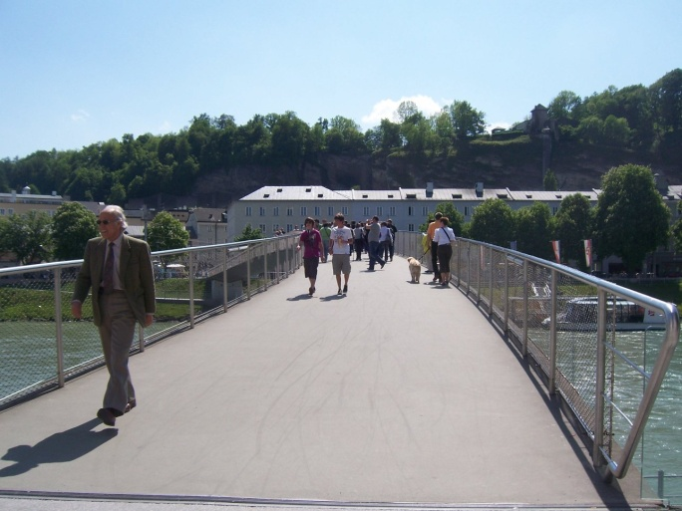
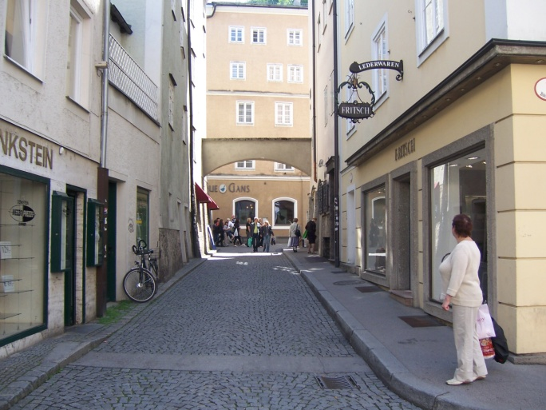
..engineering the semantic dimension

Slide 22
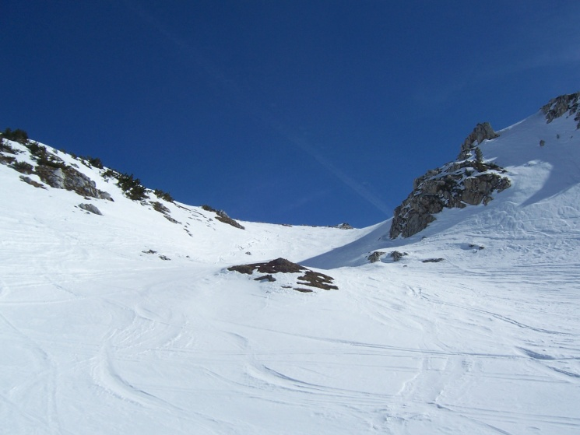

Slide 23
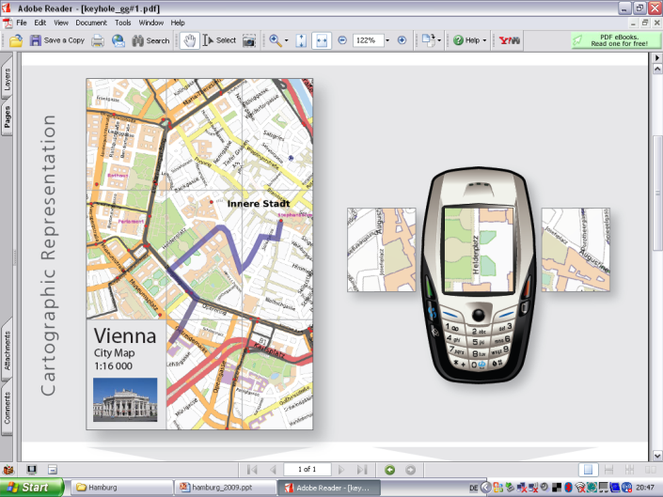
the „keyhole“ problem

Slide 24
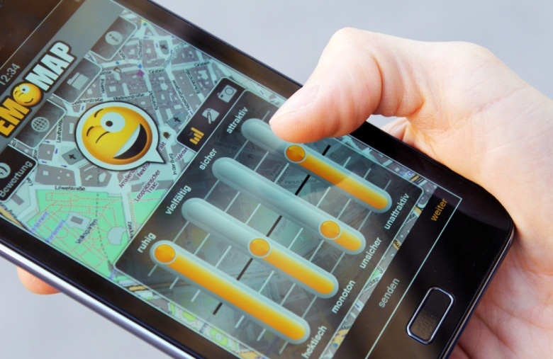
Research Group Cartography
Current Projects Emotional Mapping

Slide 25
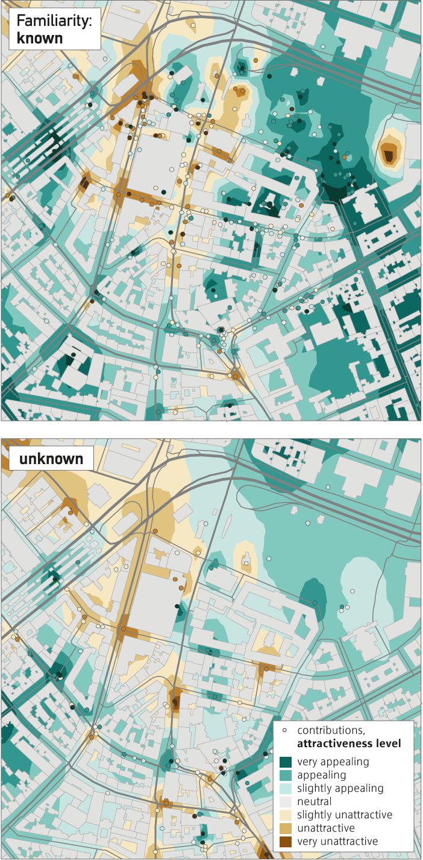
Research Group Cartography
Openemotionmap.org

Slide 26
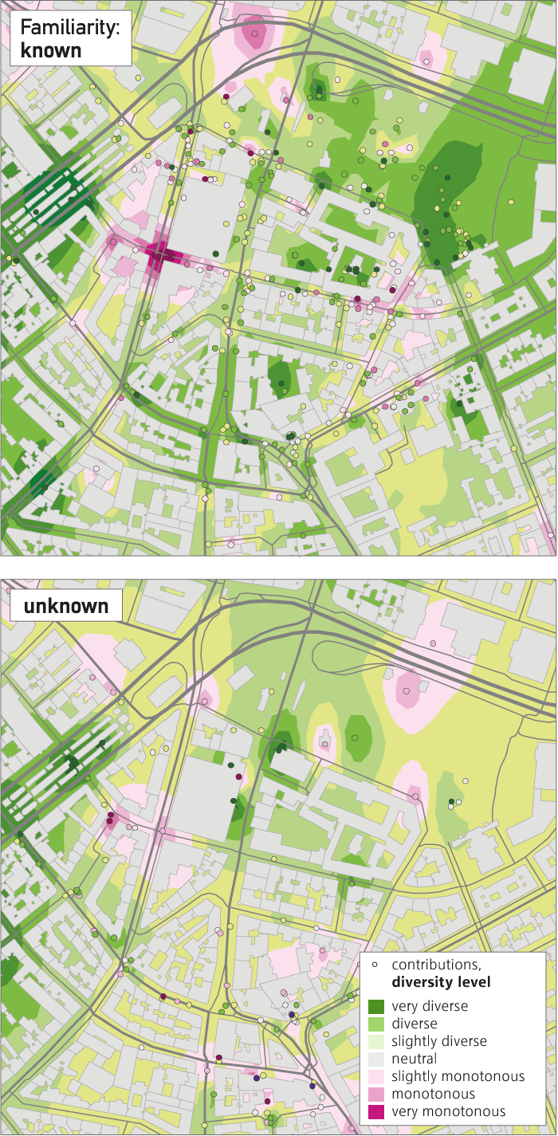
Research Group Cartography
Openemotionmap.org

Slide 27
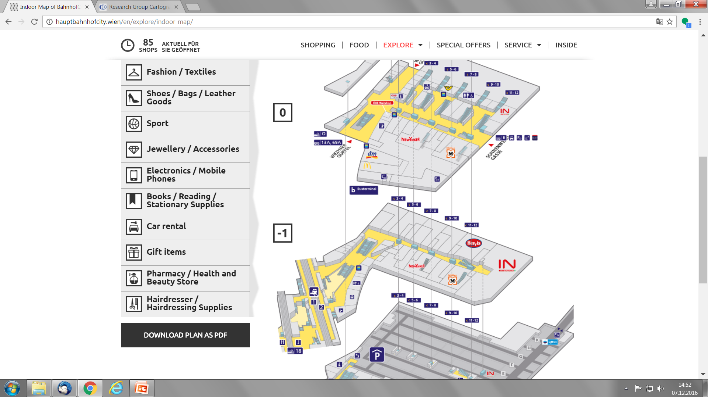
Research Group Cartography
Current Projects Indoor Maps ÖBB Railway Stations

Slide 28
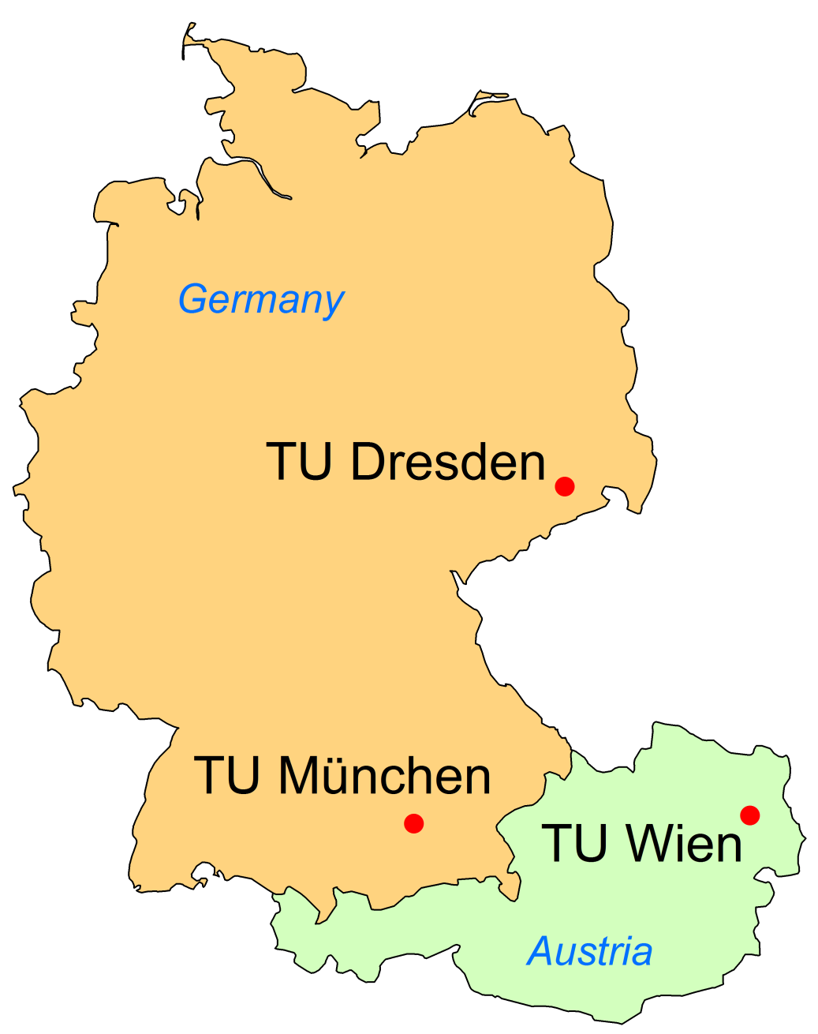
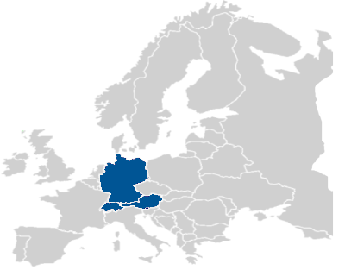




International Master „Cartography“
Notes:
28

