Slide 1



Ex Africa semper aliquid novi:
(Out of Africa always something new)
South Africa’s contribution to
20th century Cartography
Elri Liebenberg
ICA Commission on the History of Cartogaphy
Eötvös Lorand University,
Budapest, 27 June 2012

Slide 2
The African Arc of the 39th Meridian
The development of the principles
of photogrammetry
3. The Tellurometer and Electronic
Distance Measurement

Slide 3
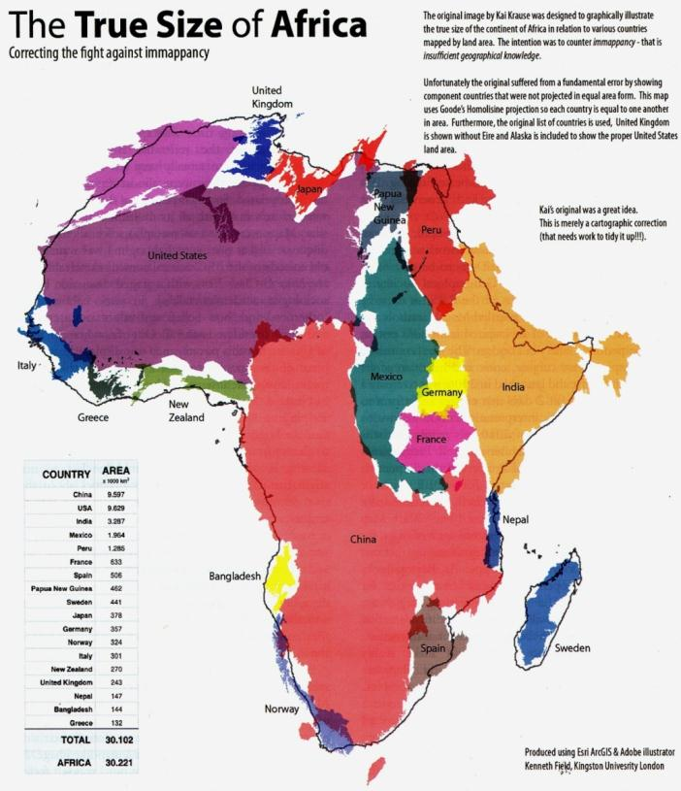
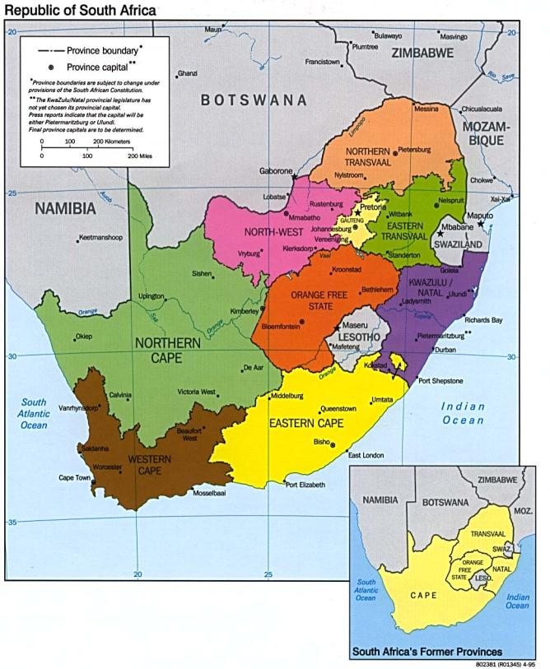

Slide 4
The African Arc
of the 30th Meridian

Slide 5
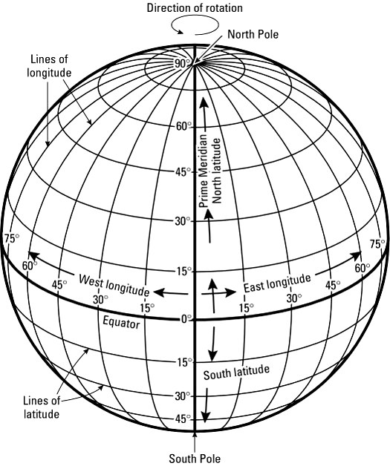
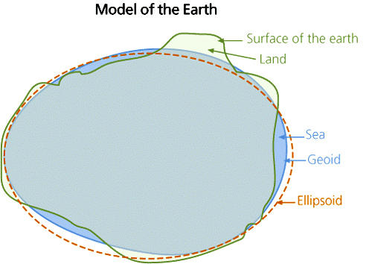
Reference ellipsoid: mathematically-defined surface that approximates the Geoid, the truer Figure of the Earth

Slide 6
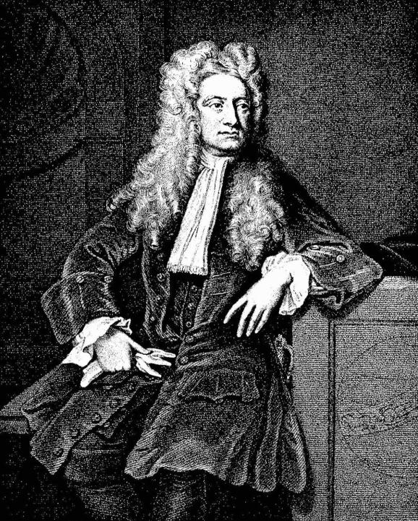
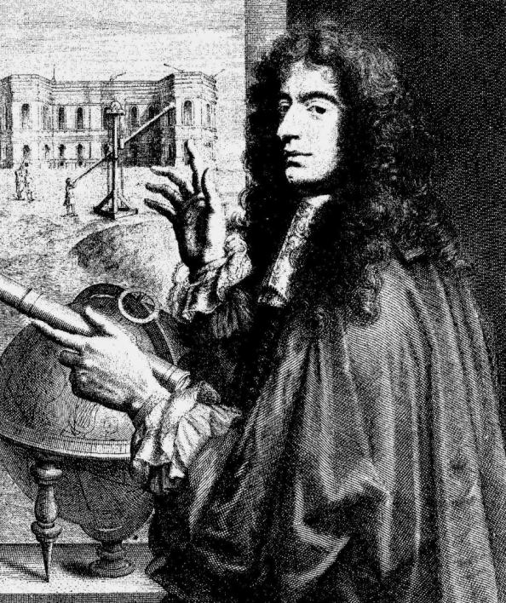
Isaac Newton, 1643-1727
Jean-Dominique Cassini,
1652-1712)

Slide 7
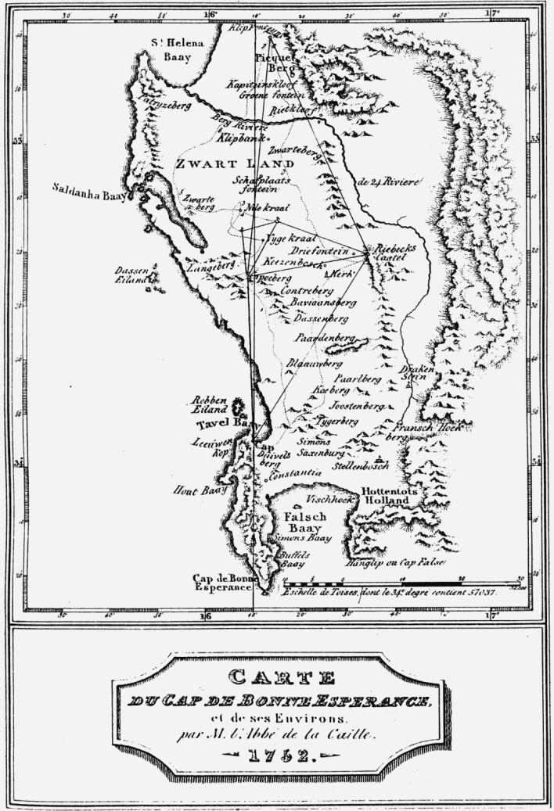
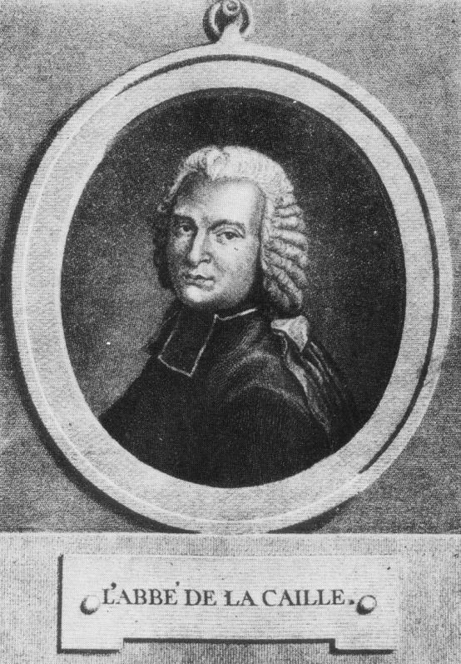

Slide 8
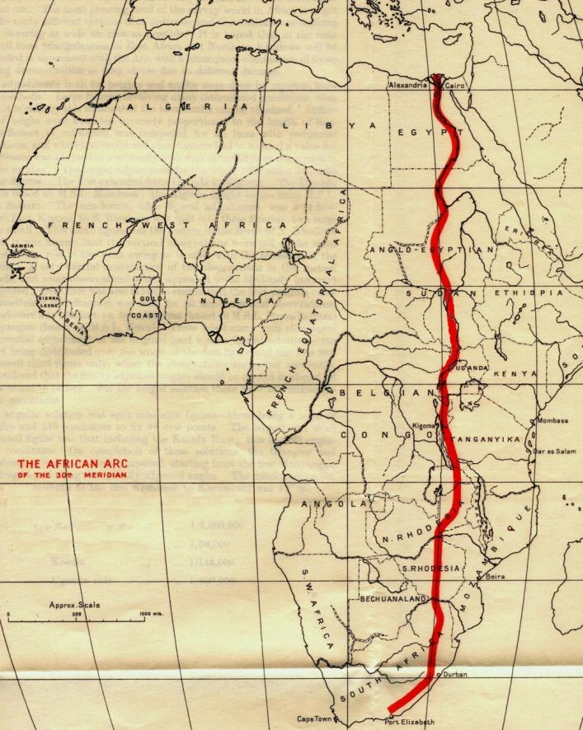
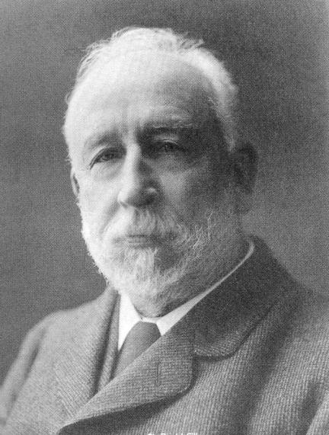
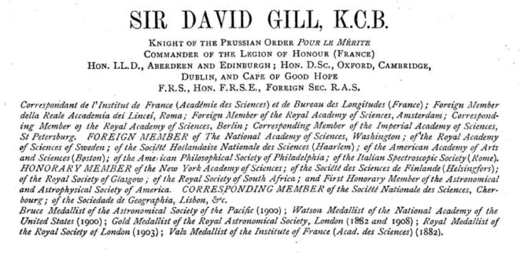
Arc of the 30th Meridian

Slide 9
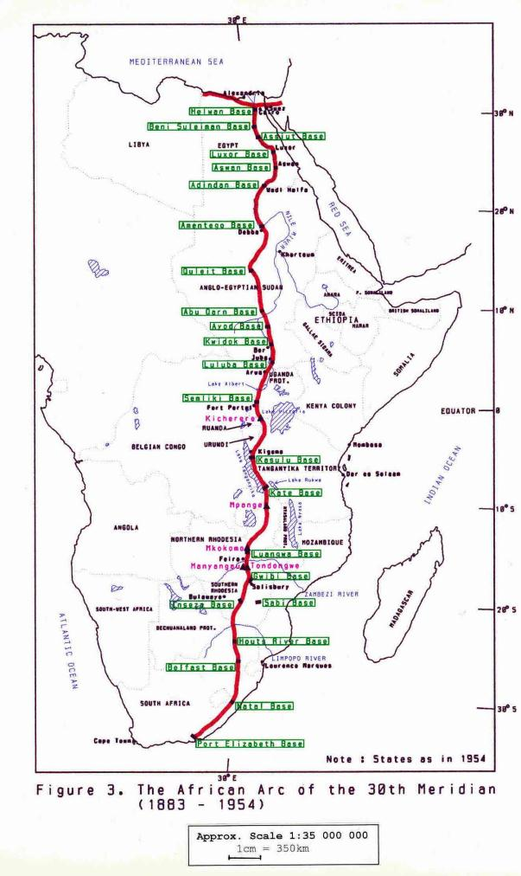
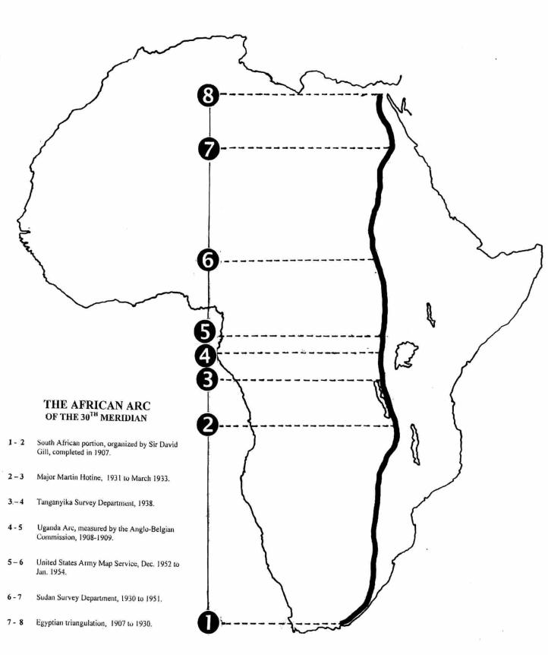

Slide 10
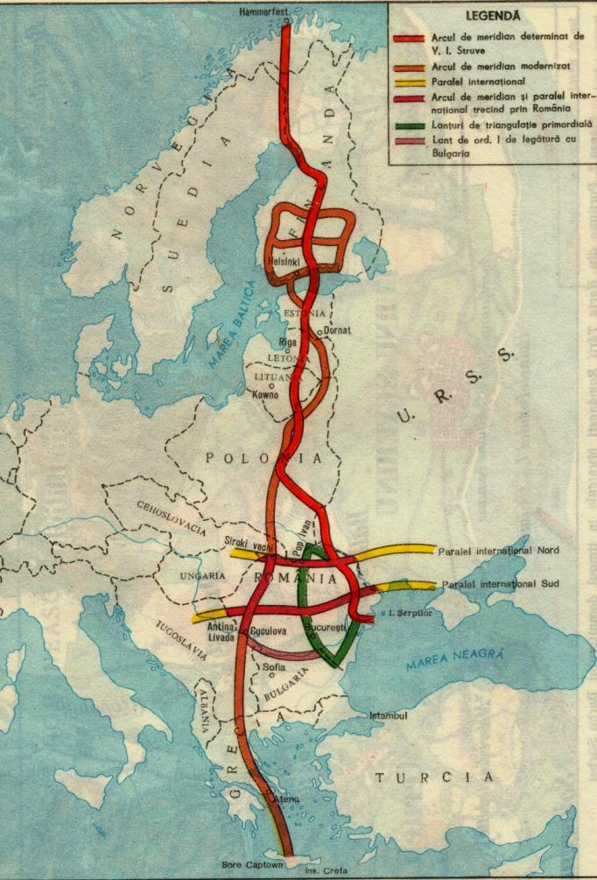
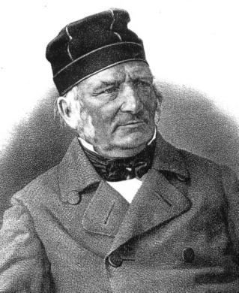
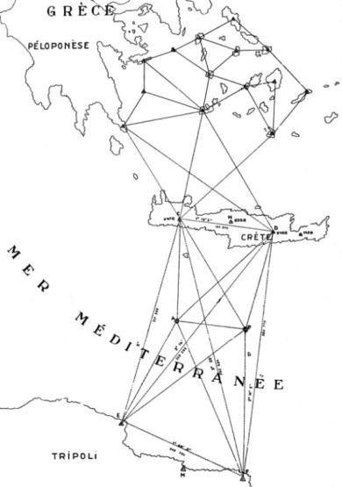
FGW von Struve
1793-1864
Connection between the Struve Arc and the African Arc
The Struve Arc, 1866-1855

Slide 11
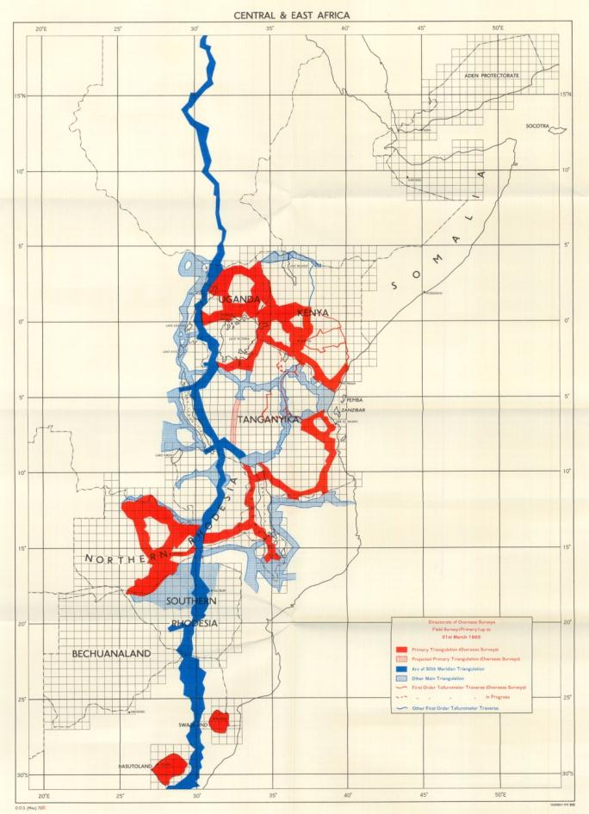
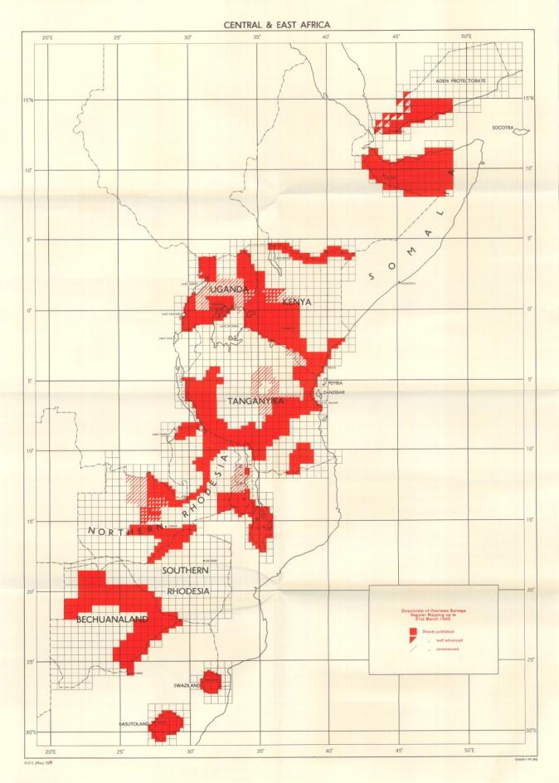
DOS surveys Central & East Africa,
1962
DOS mapping Central & East Africa, 1962

Slide 12
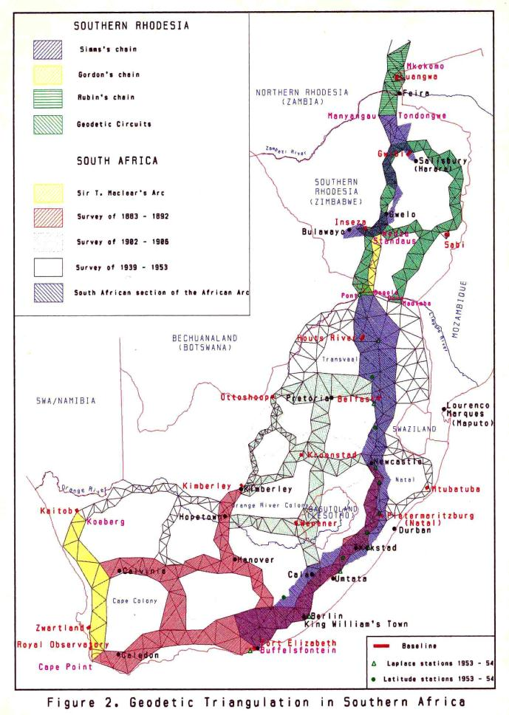
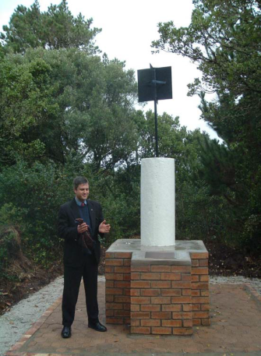
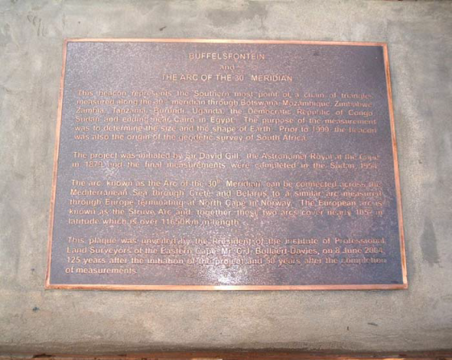
SA Geodetic Triangulation
Beacon and plaque at Buffelsfontein

Slide 13
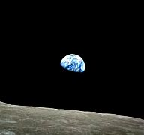
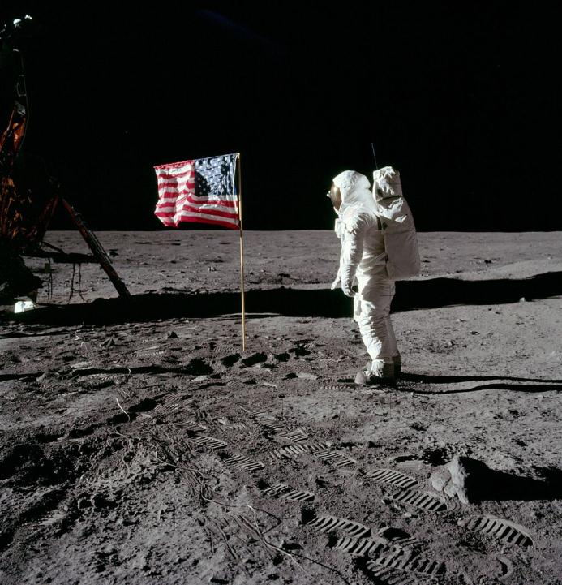
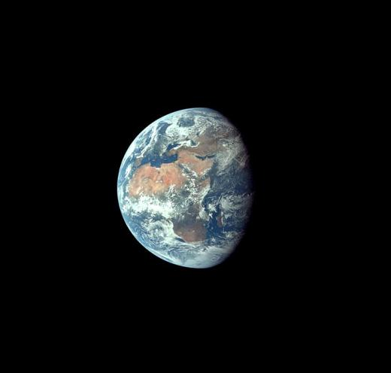
Apollo 8 lands on the moon
20 July 1969
The earth seen from the moon (top right), and from outer space (right)

Slide 14
H G Fourcade
and the
Principles of Photogrammetry

Slide 15
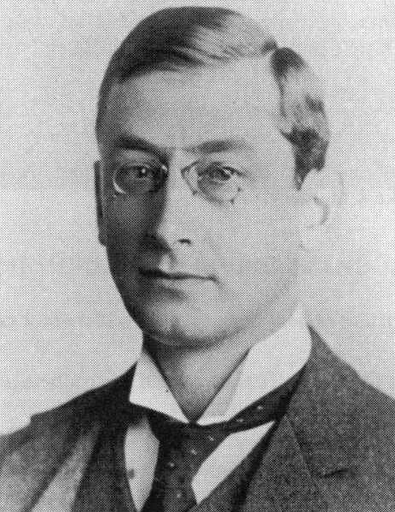
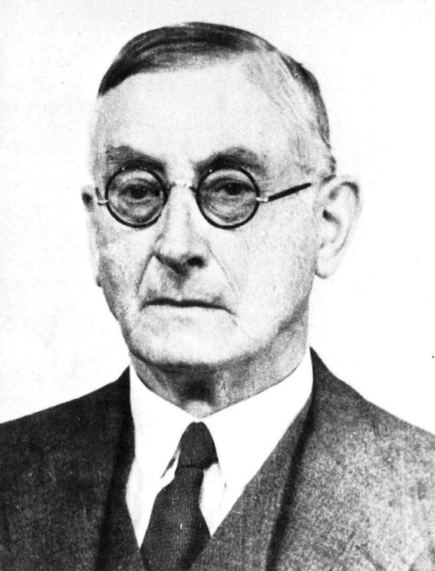
H G Fourcade
1865-1948
1940
1903

Slide 16
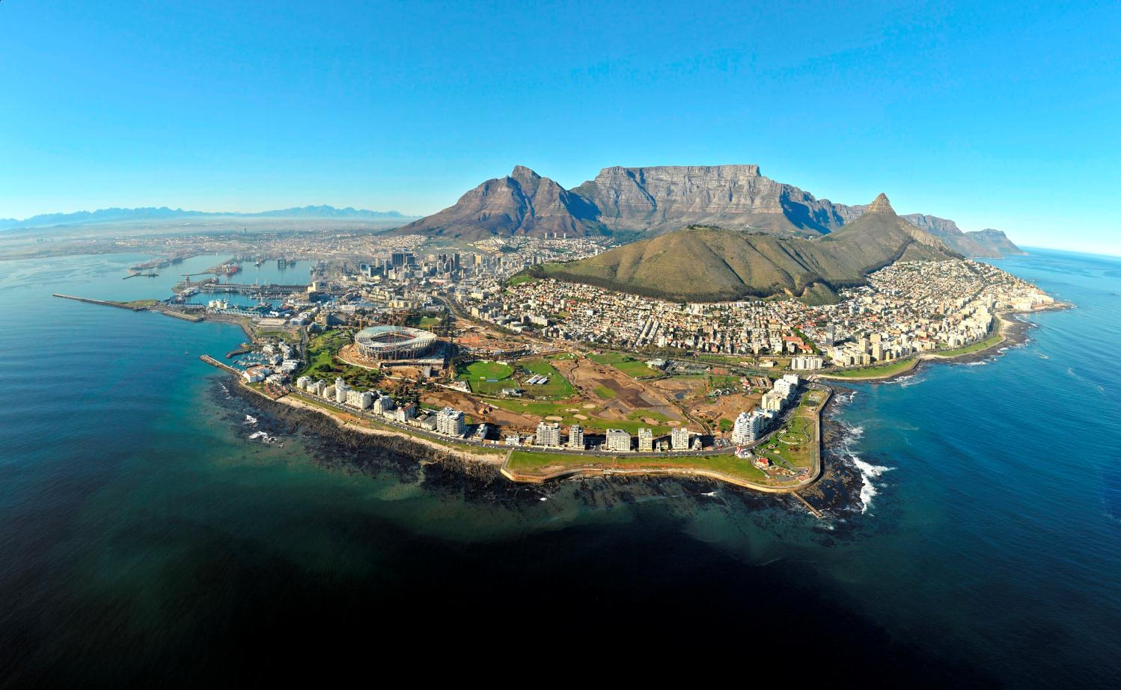
Table Mountain and the Cape Peninsula

Slide 17
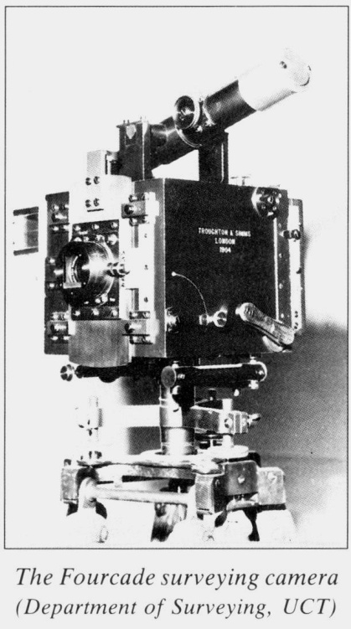
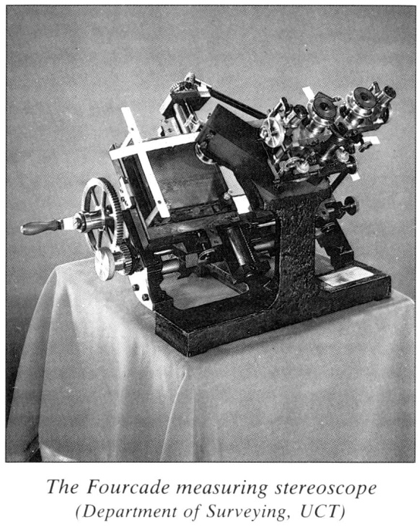

Slide 18
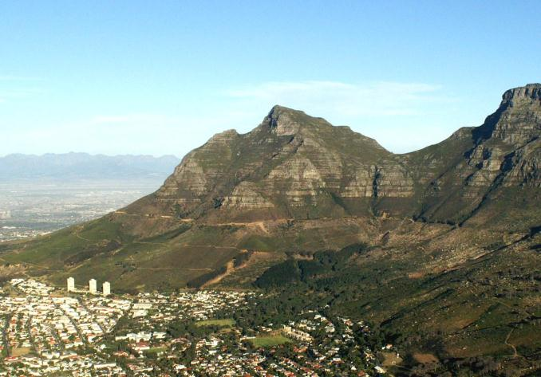
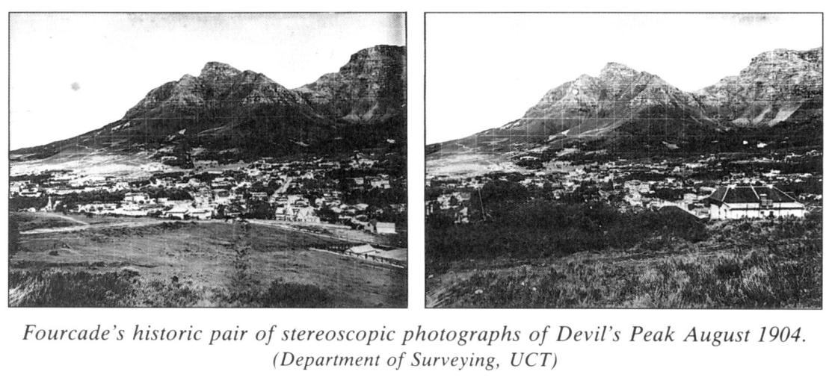
Devils’s Peak , Cape Town

Slide 19
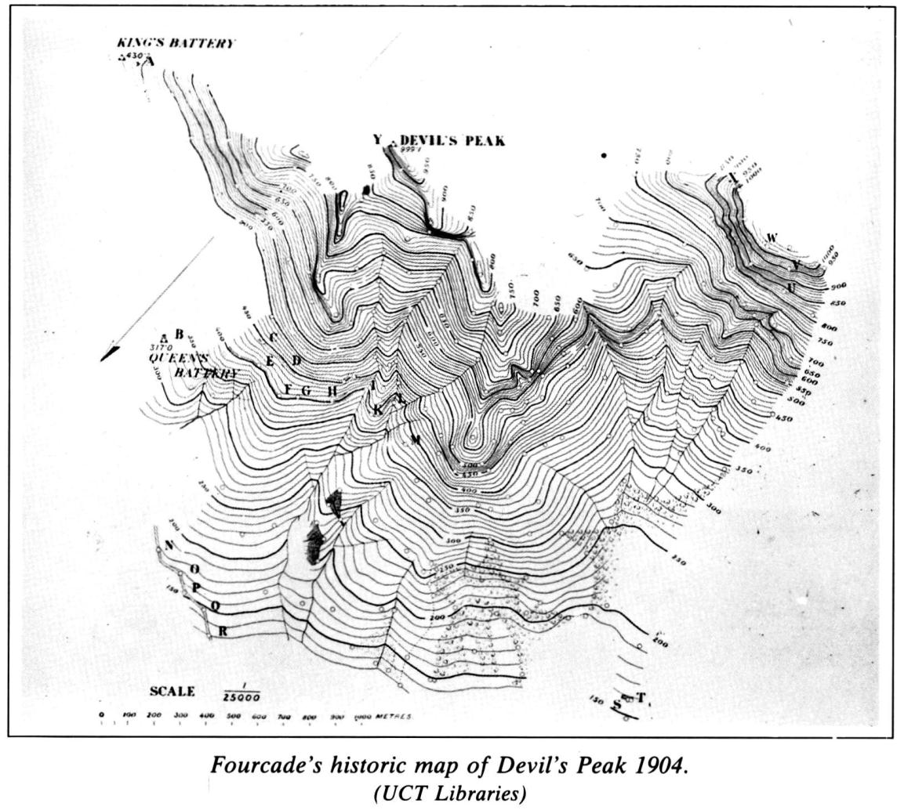

Slide 20
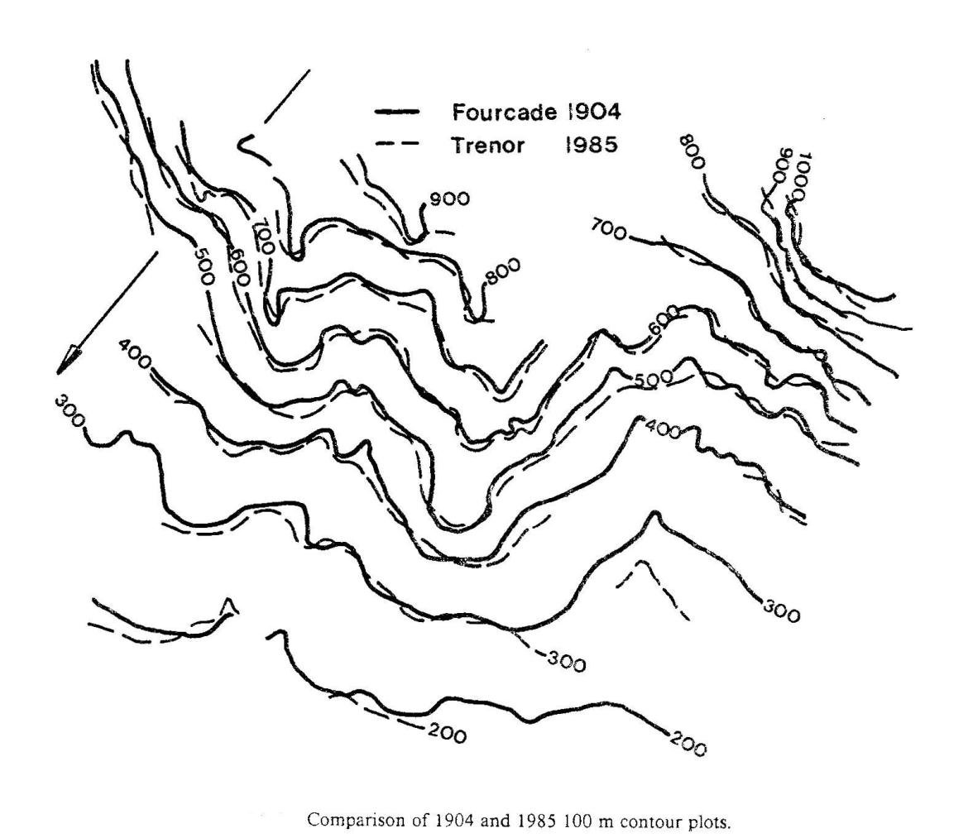

Slide 21
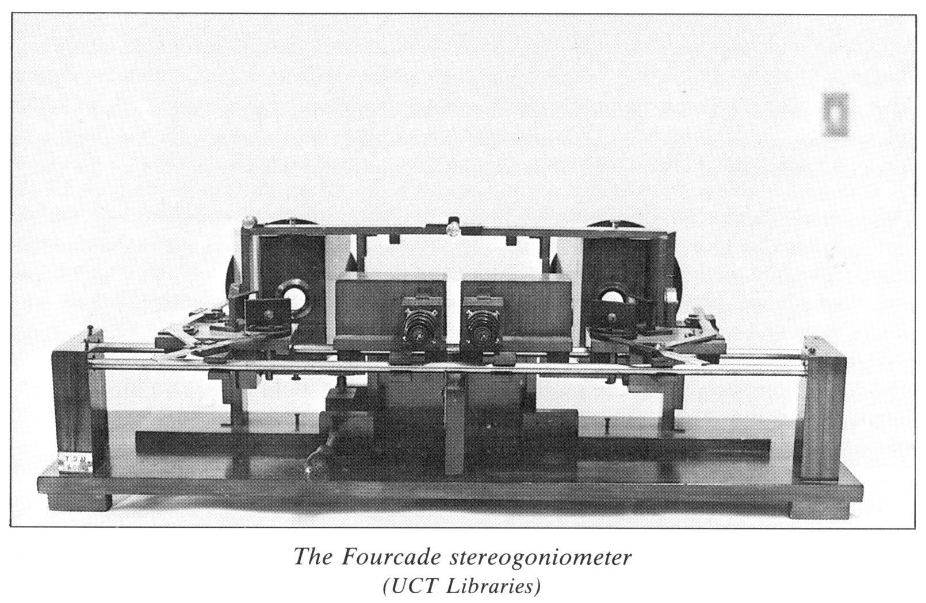
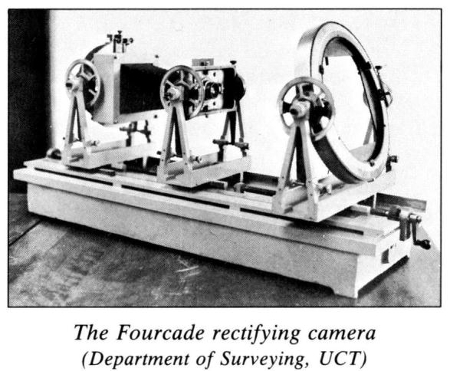
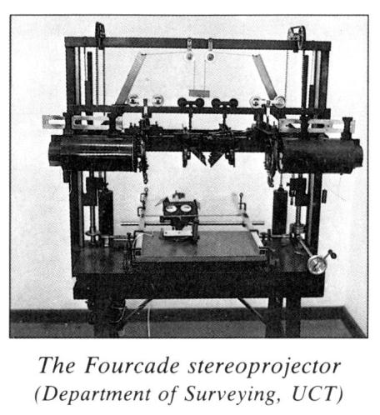

Slide 22
Trevor Wadley
and the
Tellurometer

Slide 23
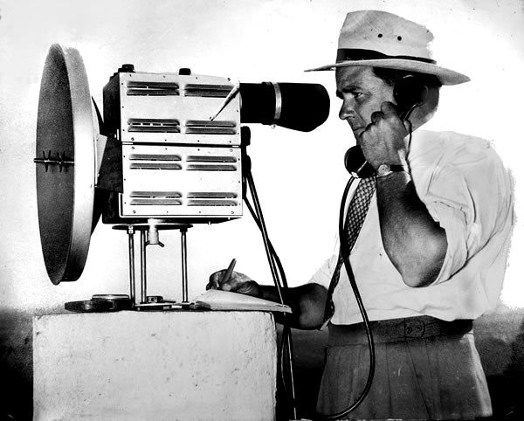
Dr Trevor Wadley tests the prototype of the Tellurometer, 1953

Slide 24
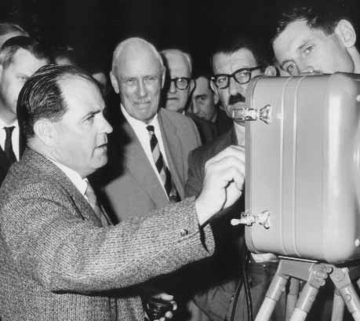
Wadley explains the principles of the Tellurometer at the British
War Office

Slide 25
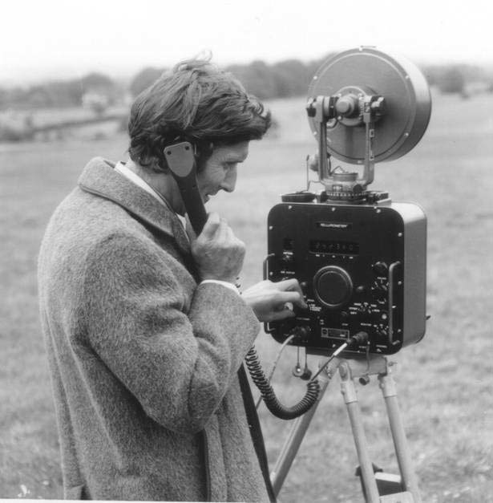
Initial testing of the prototype

Slide 26
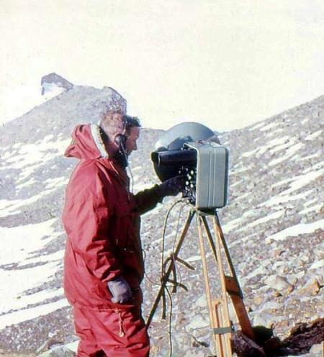
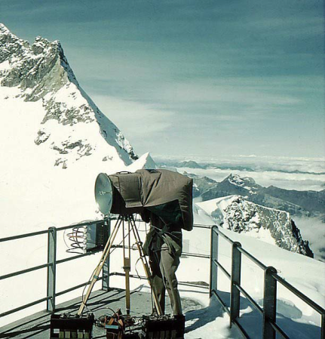
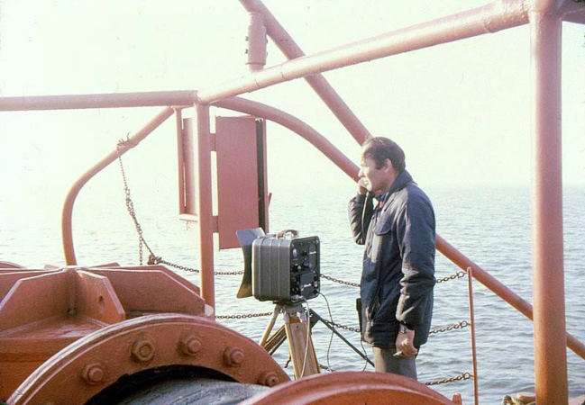
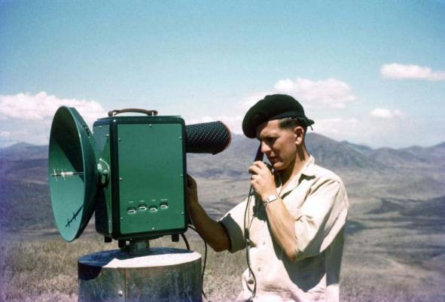
The 1950s: The Tellurometer is tested in a variety of countries and climates

Slide 27
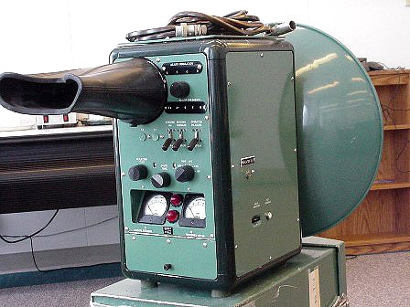
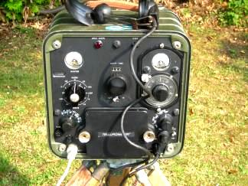
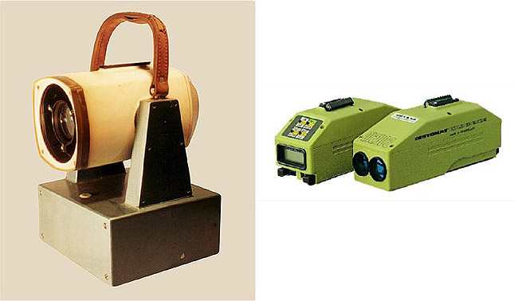
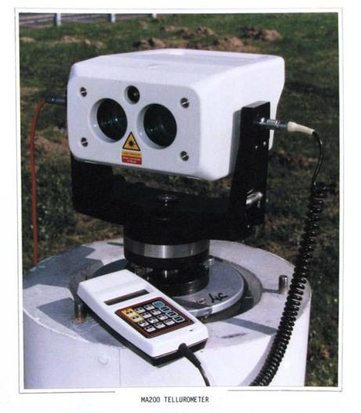
Various models were developed

Slide 28
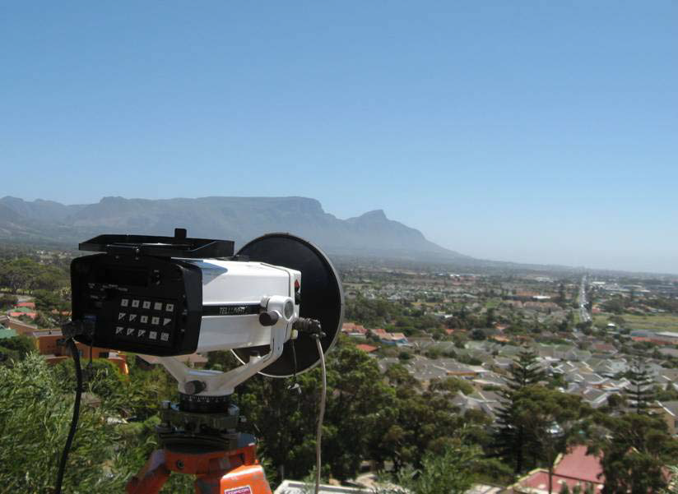
Using the Tellurometer with Table Mountain, Cape Town, in the background….

Slide 29
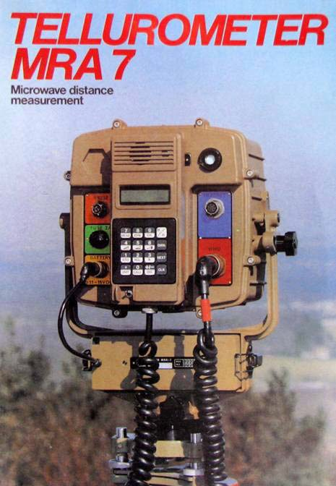
The latest model: The MRA7
manufactured in South Africa

Slide 30
Ex Africa semper aliquid novi:
(Out of Africa always something new)
Ex Africa australi semper aliquid novi:
(Out of South Africa always something
new)

Slide 31
Thank you
for your attention

