Slide 1






Federal University of Rio de Janeiro
University of Brasil
Geography Department
EÖTVÖS LORÁND UNIVERSITY
Brazilian National Spatial Data Infrastructure
Application on Rio de Janeiro State
1:25000 Mapping
Prof Dr Paulo Márcio Leal de Menezes
pmenezes@acd.ufrj.br

Slide 2
SUMMARY
INTRODUCTION
GEOSPATIAL INFORMATION (GI)
SPATIAL DATA INFRASTRUCTURE – SDI
BRAZILIAN NATIONAL SPATIAL DATA INFRASTRUCTURE – INDE
PROJECT RJ25 – 1:25.000 SCALE RIO DE JANEIRO STATE MAPPING
CONCLUSIONS

Slide 3
INTRODUCTION
GEOSPATIAL INFORMATION (GI)

Slide 4
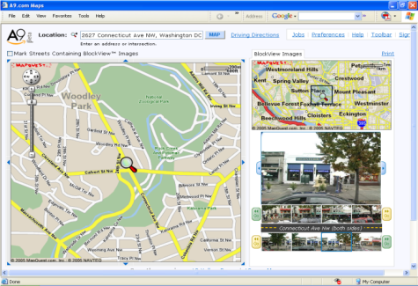
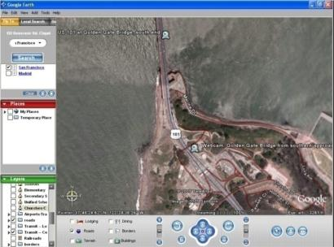
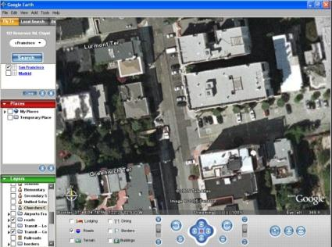
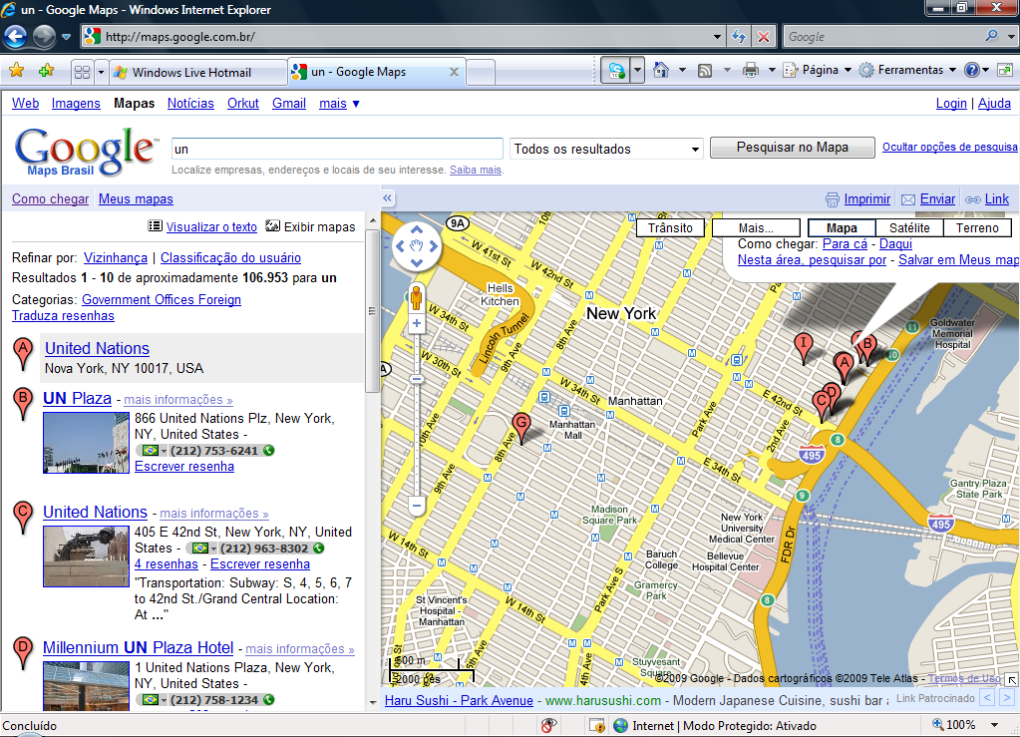
Relevance of Geospatial Information
In an interlinked world, the geospatial information is essential in various activities
More than 70% of all worldwide information used by
the public sector
can be georeferenced
A9.com; Google Earth; Google Maps

Slide 5




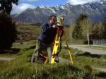
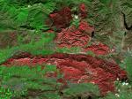

Geographic Information - Definition
Data or geospatial information is distinguished for its spatial component, which associates each entity or phenomenon a position in the Earth, translated by a geodetic reference system in a given instant or period of time, that could be flowed, among other sources, of surveying technologies, including the associated ones to any global positioning systems, supported by satellites, as well as remote sensing. Decree 6.666/08 (INDE)

Slide 6



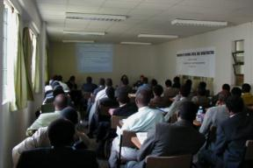
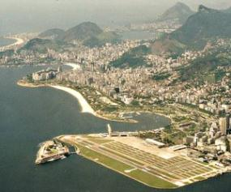

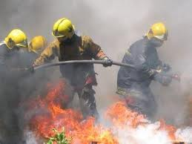




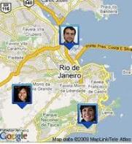
Several application segments demand GI
Defense and
Intelligence
Research and Education
Sustainable Development
Energy and Communications
Risk Management and Disaster Response
Natural Resources Management
Navigation and Positioning Systems
Electronic Government
© 2010 OGC

Slide 7
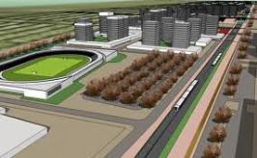




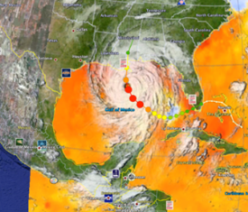

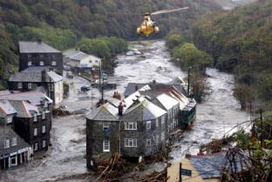

GI: more and more diversified uses
The geospatial information is essential for the decision making in local, regional and global scales.
Use or application examples are countless and they gain importance in a globalized world where there are no borders.
Agricultural Expansion
Spatial Planning
Climate Changes
Environmental
Monitoring
Warning Services
Weather Forecasting
Emergency Services
Forest Protection
Fonte: OGC

Slide 8
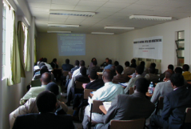
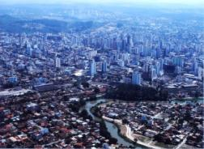

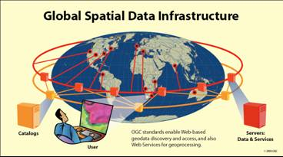




New actors and new uses of GI
Urban
Development
Education
Communications
Health
e- Gov
Civil Defense
Consumer
Market
Energy
Water Resources
Fonte: OGC

Slide 9
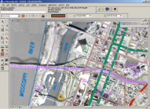
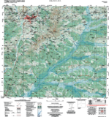

The Proliferation of New Geotechnologies
Portable Devices
GIS / Web
Low cost images
Availability’s increase and the use of Digital GI
Today´s geospatial information is easily acquired, spread and used by a variety of users and producers

Slide 10
Historical Difficulties in the Use of Geospatial Information
The production of geospatial data required high and long term investments
The efforts and investments are doubled due to a lack of knowledge of current data or those that are being produced or acquired
The current or available data are mostly incomplete or outdated
There is a lack of data sharing agreement among information producers, which interferes to the access of existing information
There is no standard usage, thus difficulting the interchange and use of current data
...

Slide 11
Motivations and benefits of a SDI
Motivations and benefits of a SDI
Since the beginning of the decade of the 90’s, the construction of Space Data Infrastructures – SDI, are considered good actions so much for the Government as well as for the society in several countries
Motivations
Objetives
The growing importance of GI inside of the information society.
The governments need to coordinate the acquisition and data offer.
The planning need for the social, environmental and economical development taking into account the spatial dimension of the information.
The government's modernization in all administration and development levels (acquisition, production, analysis and dissemination of data and information).
To share GI, initially in the public administration, and later for the whole society.
To increase the electronic administration in the public sector.
To harmonize the GI made available, as well as to register their characteristics.
To subsidize the decision making in a more efficient and effective manner
To incorporate GI produced by the private initiative.
To guarantee to all citizens the right to access public GI for decisions making
Justification:
The access to the existent geographical data should happen in an easy, comfortable and effective manner
The GI must be reused once it has been used for the project that justified its acquisition

Slide 12
Main Problems in Brazil
Increasing of GI
Availability of GI
Knowledge of existing GI
No Standardization of GI
Loss of Control of GI
No Communication and integration on GI
Loss of Data
Loss of Money
Multiplicity of Data Acquisition
No Metadata Available
Isolation on Local, Regional and Worldwide Sense

Slide 13







SDI´s Chronology
2008
INDE/Brazil
2006
IEDG/Equador, NSDI/USA – revised
2004
IDEMEX/Mexico, SNIT/Chile
2003
INSPIRE/Europe, IDERC/Cuba
2002
IDEE/Spain
2001
CGDI/Canada, ANZLIC/Australia e New Zeeland
2000
ICDE/Colombia
1996
NSDI/USA
1995
SNIG/Portugal

Slide 14
Spatial Data Infrastructure
SDI

Slide 15
SDI´s INTEGRATION
GLOBAL SDI (GSDI / GGIM)
REGIONAL SDI (CP-IDEA / GeoSur)
NATIONAL - INDE
STATE / MUNICIPAL /
Corporative / Temathic

Slide 16



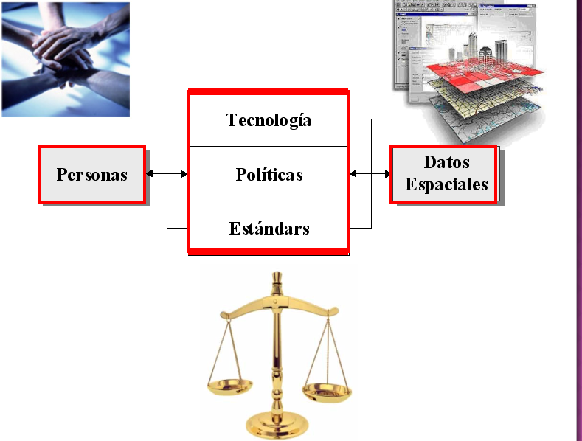
The Support of SDI
Technology
PEOPLE
Politics
GEOSPATIAL DATA
Standards

Slide 17


USER VISION OF SDI
TO FIND DATA
Catalog Server
SDI´s Services
[user point of view]
Through the Web
TO OBTAIN DATA
Map Server
To Process Data
Format Conversion
Coordinate Changes
Georeferency
Data Integration…
Standardized Computer Resources
To Buy/To Sell Data
Request Management
Security and Certification
Fonte: IDEE / ES

Slide 18
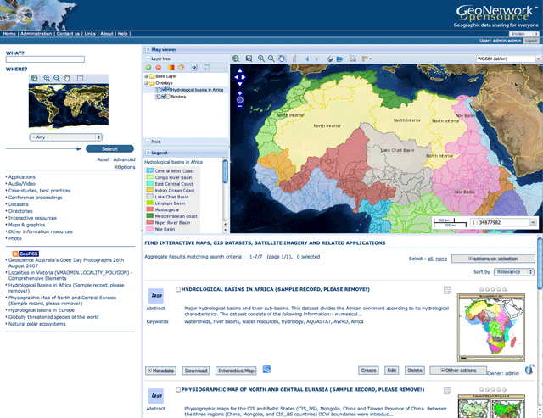
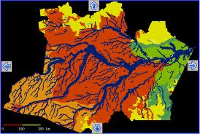
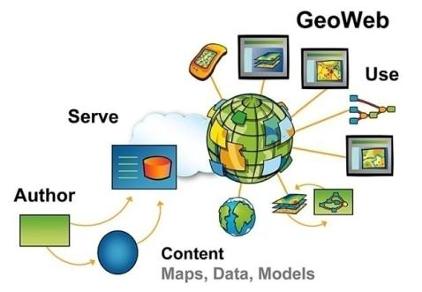
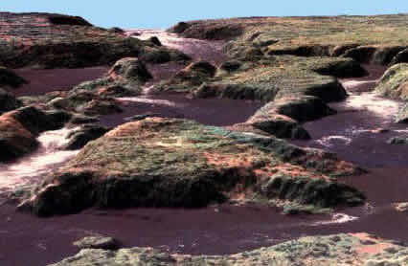
SDI´s Computational Resources
Programs, data catalogs and/or metadata, service catalogs, map, phenomenon or coverage server, web pages, etc.

Slide 19
SDI: Three Basic Elements
Data
Data and Geospatial Information (GI)
Classified in Reference and Thematic Data
Metadata
To Document and to describe data
Enables to localize, describe and evalute the GI for its use
Geoservices
Webservices to process geospatial data
Specification of public and open interfaces defined by the Open Geospatial Consortium (OGC)

Slide 20

How works a Service Oriented SDI
Service´s
(Catalogs: data and svs.)
Search
Find
Publish
Receive
Client
Provider
Request
The services architecture bases on technologies web supported as HTTP, XML, SOAP, UDDI and WSDL; and in OGC geoservices protocols : WMS, WFS, WCS, CSW, etc.

Slide 21
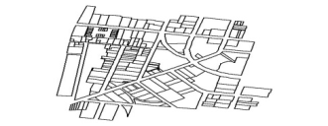
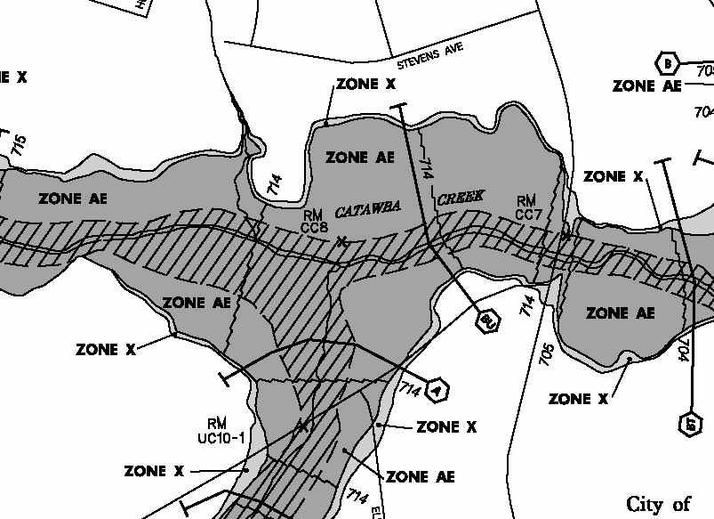
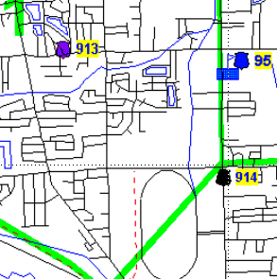
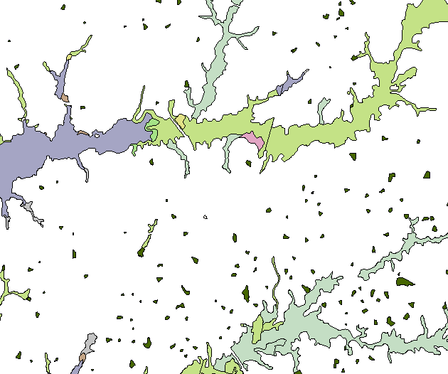
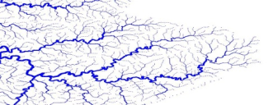
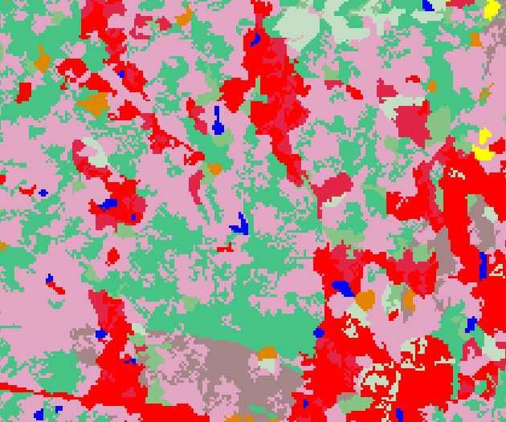
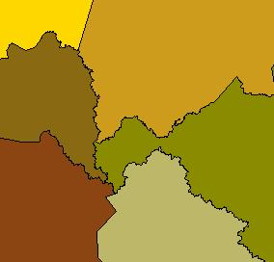





SDI´s GI Classification
Reference Data
Thematic Data
Cadaster
Toponymyn
Socio-economic
Topographic Maps
Demography
Vegetal Covering
Boarders and limits
Mineral Resources
Geodetic Control
Soils
Altimetry/elevation
Land cover and use
Images
....
....

Slide 22
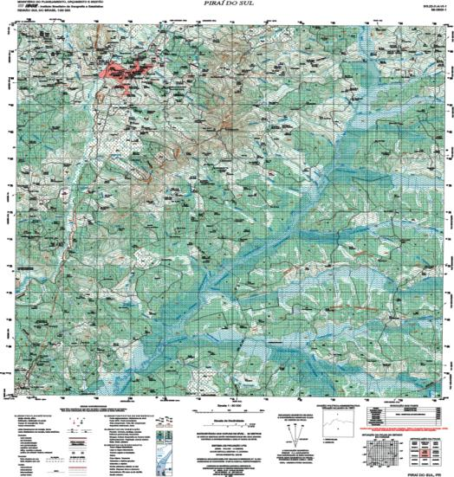
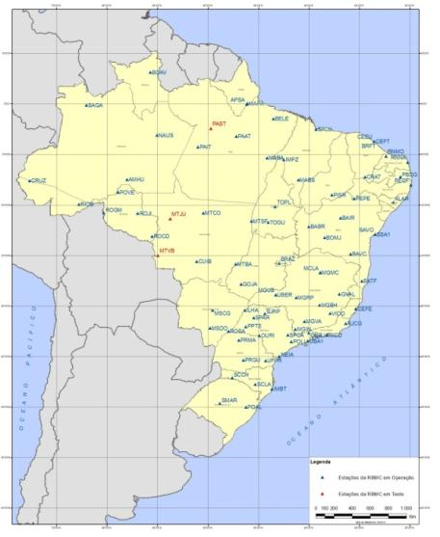
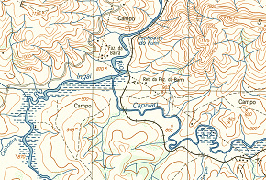
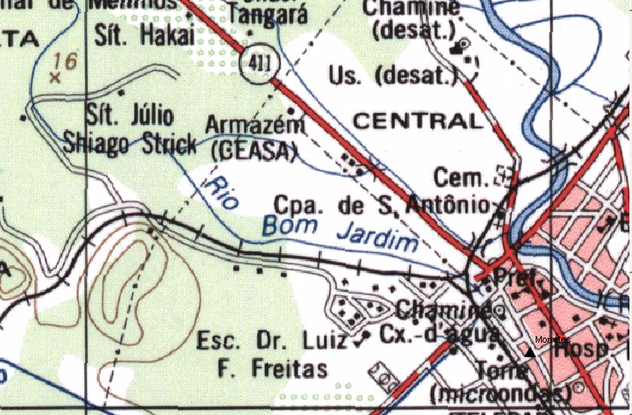
Reference Data
Reference Data: Data or groups of geospatial data, which provide general information, for non particular use, elaborated as essential bases for the geographical information referencing on the surface of the national territory.
They constitute the basic inputs for georeferencing and geographical contextualization of all territorial specific themes.

Slide 23
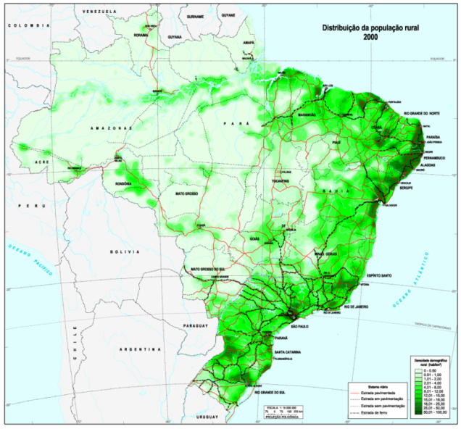
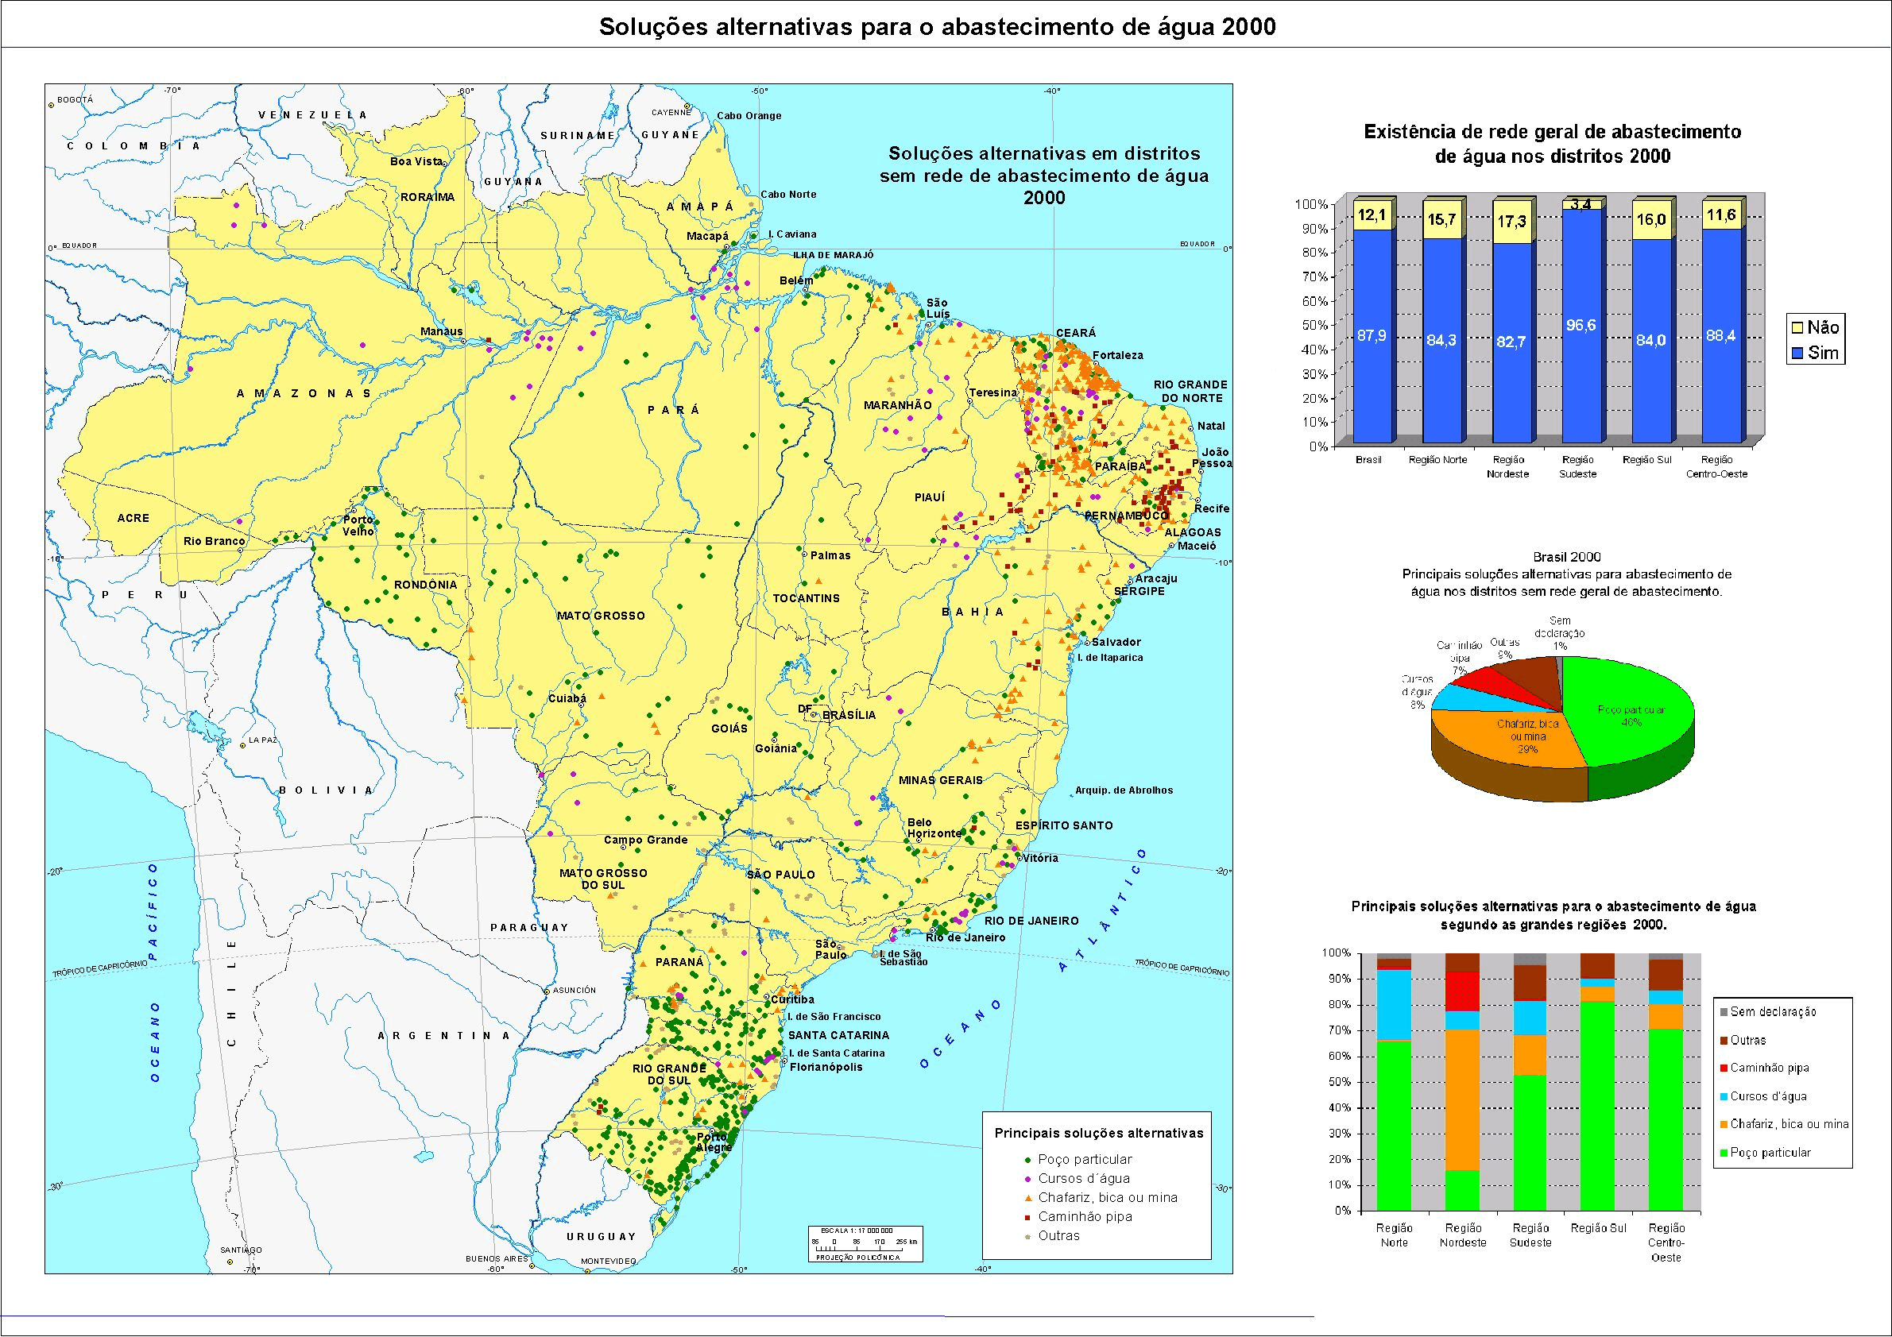
Thematic Data
Thematic Data: Data or groups of geospatial data on a certain specific phenomenon in an area of interest, or in the whole country.
Include qualitative and quantitative values spatially referenced to the reference data, and are usually linked to the main objectives of the administration at their respective producing organizations.
Distribution of Rural Population
Water Supply – Alternative Solutions

Slide 24
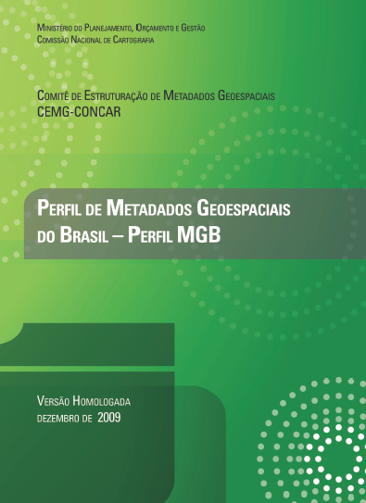
GEOSPATIAL METADATA (GM)
Data and information to register and describe geospatial data. They allow to locate, describe and evaluate GI.
Describe WHAT, WHERE, WHEN, AS and WHO, relates to the data production.
Internacional Metadata Standard - ISO 19115: “Geographic Information – Metadata”.
In Brazil – Perfil MGB da CONCAR, baseado na ISO 19115:2003 – Metadata Profile
The Brazilian Geospatial Metadata Profile was approved as official metadata for INDE on May 2009
http://www.concar.gov.br/arquivo/Perfil_MGB_Final_v1_homologado.pdf

Slide 25
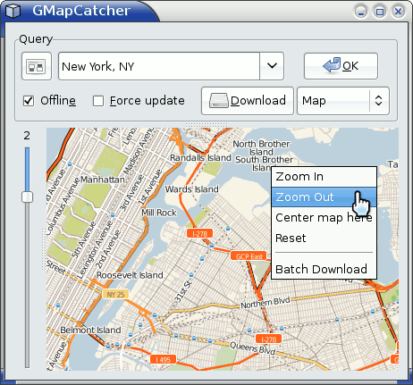
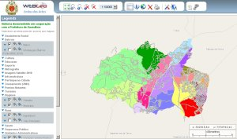
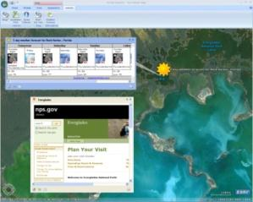
Geoservices
Functionalities worked by a browser, through Internet, that one SDI offers to users to access and to process data and geospatial metadata.
There are visualization geoservices of maps, data and metadata consultations, vectorial data transactions, Geographical Names (Gazetteer), etc.
Allow to access data of producers in any way, in any computational environment or in any GIS, where they have been produced and maintained
The web geoservices used in any SDI follow public and open interfaces defined by the Open Geospatial Consortium - OGC
Geoservices OGC
WMS
WFS
WCS
CSW
GAZETTEER

Slide 26
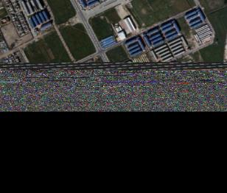
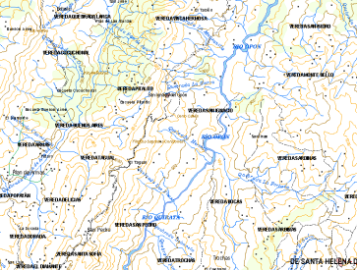
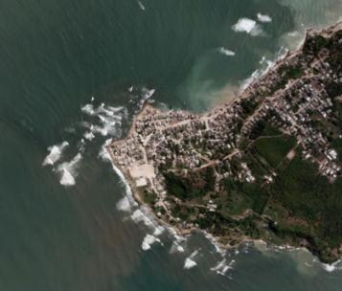
Web Map Service (WMS)
    Produces "MAPS" starting from georeferenced data
    Doesn't access directly the data, only its graphic representation
    Allows to identify elements (features)
    The produced "MAP" can cross information of raster and/or vector layers
    It allows overlap layers in different Spatial Reference Systems

Slide 27
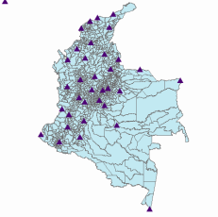
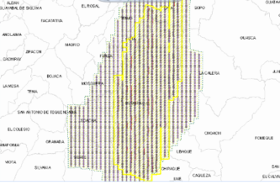
Web Feature Service (WFS)
  Produces "MAPS" starting from georeferenced data
    access directly the data
    It´s obtained vector data (GML standard)
    Allows to consult atributes of a geospatial feature (feature)
    Allows atribute edition (WFS-T)

Slide 28
Brazilian National Spatial Data Infrastructure
INDE

Slide 29


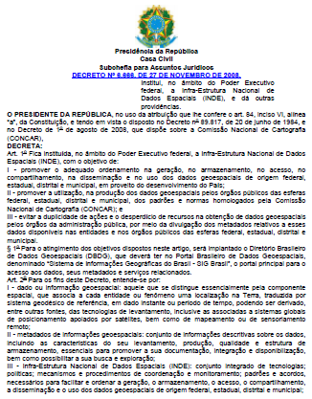

The Decree 6.666/08 – legal of INDE
Decree nº 6.666/08
The Plan of Action for Implantation of INDE was elaborated by the Committee for the Planning of INDE (CUT), constituted in the extent of CONCAR
CONCAR
INDE Coordination
National Commission of Cartography
http://www.concar.gov.br/plano_acao.aspx

Slide 30
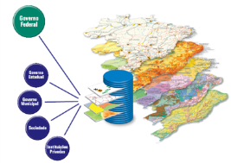
INDE Objetives
Main Objetives:
To promote the order in acquisition, storage, access, sharing, spread and in the use of the geospatial data produced by the government sector.
To promote the use, in the production of data and geospatial information by the public organizations of all government's spheres, on the standards and norms ratified by the National Commission of Cartography - CONCAR
To avoid duplicity of actions and the waste of resources in geospatial data acquistion for the organizations of public administration, through the disclosure of the metadata relating to these data
The sharing and spread of the geospatial data and their metadada is obligatory for all federal organizations and voluntary for the other government levels

Slide 31
INDE Web Service´s Modell
Geoportal GIS Brasil
(Catalogs for/
Data register and svs)
Metadata research
Provide data and metadata
User
Producer
Access data through web services

Slide 32
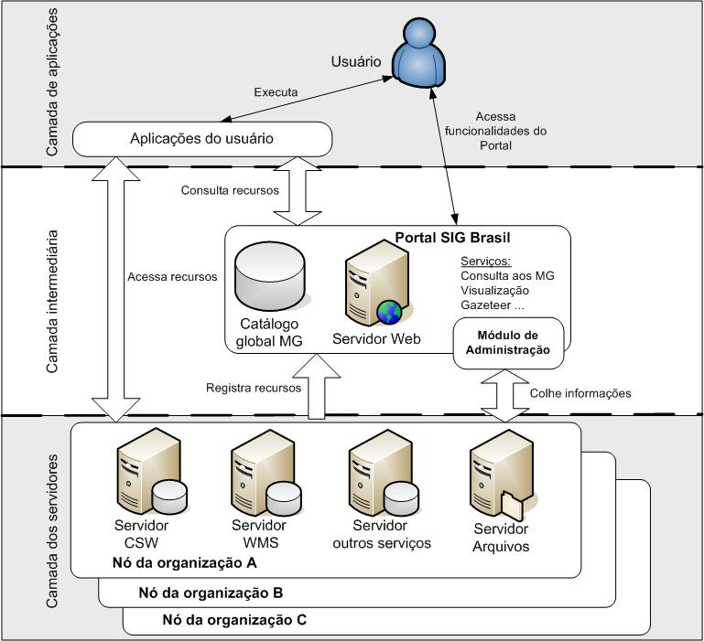
DBDG Archictecture
Diretório Brasileiro de Dados Geoespaciais
User
Application Layer
Execute
Access
Portal
funcionalities
User application
Portal GIS Brasil
Intermediate Layer
Management
Module
Services´ Layer
Node Organization A
Node Organization B
Node Organization C

Slide 33
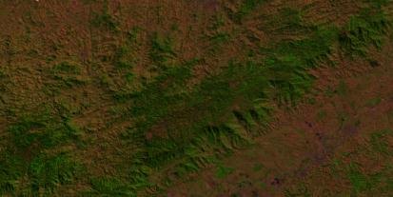
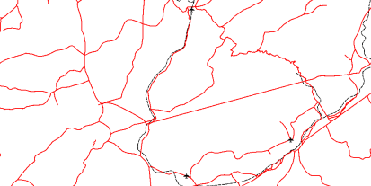









INDE Information Access
_{Satellite Images}
_{INPE}
_{Transportation System}
_{DNIT}
_{Consevation Units}
_{MMA}
_{Geodetic Network}
_{IBGE}
_{Hydrography}
_{ANA}
_{Political Division}
_{IBGE}
_{Mineral Production}
_{CPRM}
www.inde.gov.br
(Service=WMS&version=1.1.0&request=GetMap&layers)
A sintaxe dos comandos é transparente para o usuário,
que opera através de um visualizador de dados baseados em código livre e aberto

Slide 34


Standard – Geodetic Referencial
• SIRGAS 2000
To make compatible the used Geodetic Systems by South America countries, promoting the definition and establishment of a unique referential accurately compatible with the current positioning technology
Geodetic Reference System: ITRS (International Terrestrial Reference System)
Earth´s Geometric Figure: Geodetic Reference System 1980 – GRS80
Major semi-axix a = 6.378.137 m
Flatness f = 1/298,257222101
Origyn: Earth´s mass center
Orientation:
Poles e reference meridian accuracy in ±0,005” with defined directions by BIH (Bureau International de l´Heure), in 1984,0.

Slide 35

Place Names Standardization
Committee de Estruturação de Nomes Geográficos - CNGEO
•CONCAR – National Authority in Place Names (Toponymy)
•Sources – Resolutions from UNGEGN
•In composition – National Network of Geographical Names
•In development – National Politics and Guidelines in Geographical Names

Slide 36

Committee of Standards in Cadaster Mapping - CNMC
Objetive: Development of Guidelines and Standards to Cadaster Mapping Scales - 1/10.000 a 1/500
Steps
Finalized Standards for:
•Air Survey
•Field Control
In Work:
•Phototriangulation
•Object Catalog
•Deambulation
•Data Acquisition
•Digital Elevation Model

Slide 37
Technical Specifications
ET-RDGV
Cartographic representation of the Vectorial geospatial Data
ET-ADGV
Geometry Acquisition of the Vectorial geospatial data
.....
ET-Metadata
ET-EDGV
Vectorial Geospatial
Data Structure
Responsability:
CONCAR
CONCAR / DSG
ET-EDGM
Matricial Geospatial Data Strucuture
ET-CQDGV
Quality Control of Vectorial and Image Products

Slide 38

Vectorial Geospatial Data Structure
ET-EDGV
Committe of National Digital Map Library – CEMND
•
•
•
•
Data structure and modeling of geospatial data
Object oriented modeling. Scales < 1/25.000
Approved Versions – 1.0 – 2006 / 2.0 – 2009
Public Consult – dez 2010 e jan 2011
• New Version in development
Information Categories
The Brazilian Geographical Space was divided in 13 (thirteen) information categories:
Hydrography, Relief, Vegetal Covering, Transport System, Energy and Communications, Water Supply and Basic Sanitation, Education and Culture, Economic Structure, Urban Places, Boarders and Limits, Reference Points, Public Administration, Health and Social Service

Slide 39
Information Categories
Session 1 | Hydrography | Set of Oceanic and inner waters of the terrestrial surface, as well as natural or artificial, emerged or submerged elements,contained in that environment.
Session 2 | Relief | Category that represents the shape of the Earth surface and bottom of the waters treating, also of the exposed materials, except for the vegetal covering.
Session 3 | Vegetal Covering | Represents, in general character, the several types of natural and cultivated vegetation.
Session 4 | Transport System | Category that groups the set of systems destined to the transport and load displacement and passengers, as well as the support structures tied to these activities.
Session 5 | Energy and Communication | Category that represents the structures associated to the generation, transmission and distribution of energy, as well as the ones of communication.
Session 6 | Water Supply and Basic Sanitation | Category that contains the group of structures associated to reception, to storage, to treatment and water distribution , as well as the relative ones to the basic sanitation.
Session 7 | Education and Culture | Category that represents the areas and the constructions associated to education, to sport, to culture and leisure.
Session 8 | Economic Structure | Category that represents the areas and constructions where are accomplished activities for production of goods and services that, in general, present economical result.
Session 9 | Urban Places | Category that represents the several types of concentration of human houses.

Slide 40
Session 10 | Reference Points | Category that contains the classes of elements that serve as reference to measurements relating to the Earth surface or of natural phenomena.
Session 11 | Boarders and Limits | Category that represents the different levels politician- administrative and the special areas; planning operational areas, private areas (no classified in the others categories), as well as the elements that delimit materially these lines on the Earth surface.
Session 12 | Public Administration | Category that represents the areas and the constructions where areaccomplished the inherent activities to the public power.
Session 13 | Health and Social Service | Category that represents the areas and constructions relating to the Social service and to health.

Slide 41

Class Diagram for the Hydrography Category

Slide 42




ET-ADGV
Technical Specification for Acquisition of Vectorial Geospatial Data
Show the “Know-How” for the acquisition of each class of defined categories
Dicionário de
Dados

Slide 43

ET-RDGV
Technical Specification for Representation of Vectorial Geospatial Data

Slide 44
INDE GI Data Classification
Reference Data | Thematic Data
Special Areas Heights Hydrography Limits Assestments Basic Cadaster Mapping Basic Terrestrial Mapping Land Use Toponymy Geodetic Networks Remote Sensing | Wheather and Climate Vegetal Cover Geodiversity Geology and Mineral Resources Geomorphology Hydrology and Hydrics Resources Soils Archeology Speleology Land Use and Cover Biodiversity Zonings and Managements Environmental Management Agropecuary and Fishing .......... | Public Facilities Transports Education Health Energy Comunications Housing, Sanitation and Urbanization Culture Sporte and Leisure Extractive Industry Transformation Industry Socioeconomy Justice Defense ..........
Categories
Special Data | Geoinformation
Nautical Cartography Aeronautical Cartography | Atlas Environmental Data Base Cartografphy ............ | Scientific Collections Geography Geodesy .............
Categories
A classificação acima, elaborada em Março 2012, será usada como base no novo Portal da INDE e na
revisão do Perfil MGB – Anexo 5.3; este é um exemplo de exercício de padronização

Slide 45
INDE IMPLANTATION STEPS
STEP I Ago 2009 to Dez 2012
STEP II
2013 to 2016
STEP III
2017 to 2022

Slide 46
INDE IMPLANTATION STEP I
STEP I Ago 2009 to Dez 2012
Step I Objectives
Release of GIS Brasil with tools for search, exploration and access data and metadata, besides maps visualization (WMS)
INDE Release (08/4/10)
Step I Objectives
Node Implantation of GDDB in the main government producers
Wide metadata availability according the MGB profile
Availlability of the largest possible amount of given geostatial and thematic reference geoespaciais and thematic
Beginning of the training and of HR training, diffusion and INDE popularization

Slide 47

INDE IMPLANTATION STEP II
INDE Consolidation in all Government levels
Increasing services offer according users demand
Strengthening Institutional and people components
To become
INDE - main Brazilian search, exploration and access tool for geospatial data to support the formulation of public politics and government actions

Slide 48
INDE IMPLANTATION STEP III
Main search, access and use tool for GI available for the Society
International Reference – efective contribuition for transnational projects
GLOBAL SDI (GSDI / GGIM)
REGIONAL SDI (CP-IDEA)
NATIONAL SDI - INDE
STATE / MUNICIPALITY SDI
Corporatives / Temathics SDI

Slide 49

INDE FUTURE VISION (STEP III)
Internet
Infra de serviços web OGC *
Users and Clients
Providers
Requesting
information
Government
Published
Academy
Locate and Request
Catalogs and Registers
Private Sector
Adding
information
NGOs
Provides
information
Soft Clients
GIS Applications
Mobile Devices
Companies, Agencies,
Organizations offering
data and on line svs.
* Baseada em tecnologias web de suporte como HTTP, XML, SOAP, UDDI e WSDL; e nos protocolos de geoserviços OGC: WMS, WFS, WCS, CSW, etc.

Slide 50
Project RJ25
1: 25.000 scale Rio de Janeiro State Mapping

Slide 51
Project RJ25
1: 25.000 scale Rio de Janeiro State Mapping
Objectives : Development of a continuous map in 1:25.000 scale and all
derivated cartographic products to support the needs of the
State Government and Users.
Cartographic Products: 1: 25.000 continuous map
1: 25.000 topographic sheets
1: 25.000 Digital Terrain Model
1: 25.000 Orthophotomaps
The first complete mapping project under the National Spatial Data Infrastructure

Slide 52

Rio de Janeiro State – Southeastern Region - Brazil
Area: 43,696.054 km²

Slide 53
Rio de Janeiro State – Southeastern Region - Brazil
Project Data
- Airphotography: 3842 photos ( 17 Blocks)
- Number of Sheets: 322
- Field Control (GPS) : 1285 HV
- Orthophotos: 322 (one per sheet)
- DTM: 322 (one per sheet) and state integrated
- Survey of all Conservation Units in the State

Slide 54

17 Blocks

Slide 55


Slide 56


SHEET 27483-NO – Búzios - SF24YAIV3NO
DTM
Orthophoto

Slide 57

SHEET 27483-NO – Búzios - SF24YAIV3NO
Vector - shapefile

Slide 59

ENGEFOTO - Done
IBGE – Almost Done
Final work

Slide 60
NEXT STEPS
Link Engefoto and IBGE works: all categories
Database union
Development of the State Continuosu Map (Equirretangular Projection)
Development of 322 sheets (UTM Projection – Zones 23 and 24)
Analysis and availability of Metadata

Slide 61

IBGE – National Spatial Data Infrastructure Viewer
Available in: http://www.visualizador.inde.gov.br/

Slide 62
CONCLUSIONS

Slide 63
The INDE – National Spatial Data Infrastructure is an initiative of interest of the State and of the Brazilian society.
It supplies the necessary geospatial support for integration of politics and direction of interventions in the Brazilian territorial space, in that way generating benefits quantified to the citizens, companies and government.
It is a reality and cannot more stop

Slide 64

23rd – 28th August 2015

Slide 65



I C C 2 0 1 5 – R I O !
Just to Remember, this is important !!!
We´ll meet you there!!!

Slide 66
Thank you for your attention!!!

