Slide 1
Standardization of geographical names: the United Nations outreach to individual countries
Helen Kerfoot and Ferjan Ormeling
Notes:
1

Slide 2
Early days at the UN
UN Economic and Social Council (ECOSOC) 1948
First Regional Cartographic Conf. for Asia and Pacific 1955
ECOSOC resolution 715 A (XXVII) 1959
First meeting of UN Group of Experts
on Geographical Names in 1960
First Conference on the
Standardization of Geographical
Names in 1967
• national standardization
• basis of international standardization (romanization)
• resolution I/4 … foundation (1967)

Slide 3
Notes:
3

Slide 5
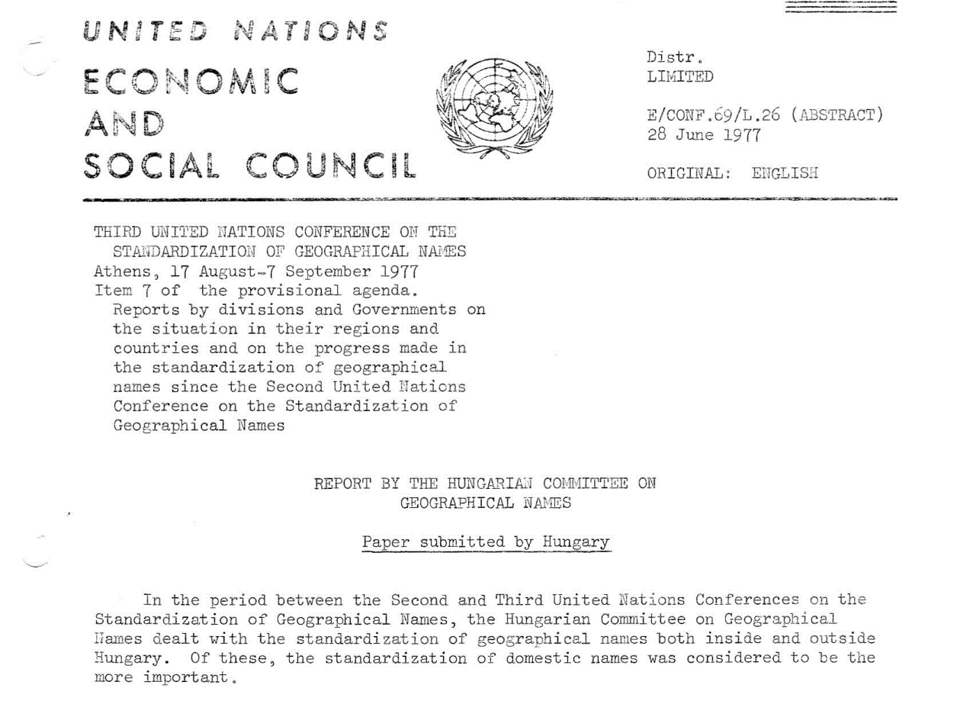
UNCSGN Resolution I-4

Slide 6
UN Conferences 1967-2007
350
300
250
Delegates
200
P a r t i c i p a t i o n
Countries
150
100
Special
agencies
50
0
1
2
3
4
5
6
7
8
9
C o n f e r e n c e N o.
Notes:
6
6

Slide 7
Notes:
7

Slide 8
UNGEGN structure
UN Conferences on the Standardization
UNGEGN Secretariat
(UN Statistics Division)
of Geographical Names (UNCSGN)
UNGEGN Bureau
UN Group of Experts on
Geographical Names
(UNGEGN)
Country Names
UNGEGN liaison
with scientific groups
Toponymic Data Files and Gazetteers
PAIGH
Publicity and Funding
Toponymic Terminology
D i v i s i o n s
ICA
Romanization Systems
23
W o r k i n g g r o u p s
linguistic/geographical
Training Courses in Toponymy
divisions
ICOS
Evaluation & Implementation
IHO
Exonyms
Pronunciation
Task Team for Africa
ISO
Indigenous/Minority/Regional Names
Toponymic Guidelines
Coordinator
SCAR
Ijsselmeer>IJsselmeer
IAU
Notes:
8
8
Isolde has participated in many aspects of UNGEGN
... UNGEGN sessions .... ?since 1994
.... WGs .... Inc. Toponymic Terminology, Training 2004, Exonyms, Pronunciation ...
.... Dutch- and German-speaking Division Chair ....
Toponymic Guidelines ... Coordinator (following Josef Breu, Peter Raper)

Slide 9
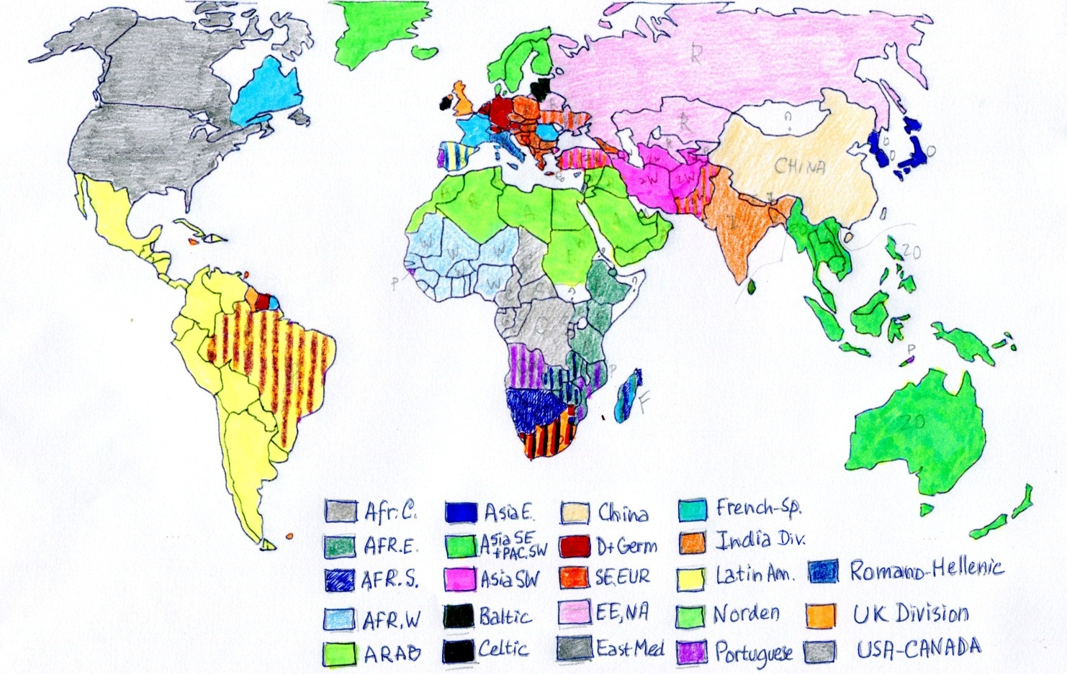
UNGEGN Divisions
Africa Central
Africa East
Africa South
Africa West
Arabic
Asia East
ASEast Pacific S-W
Asia South-West
Baltic
Celtic
China
DGsD
South-East Europe
NE Europe, N. Asia
East Med
French-speaking
India
Latin America
Norden
Portuguese
Romano-Hellenic
United Kingdom
US/Canada
Notes:
9

Slide 10
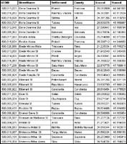
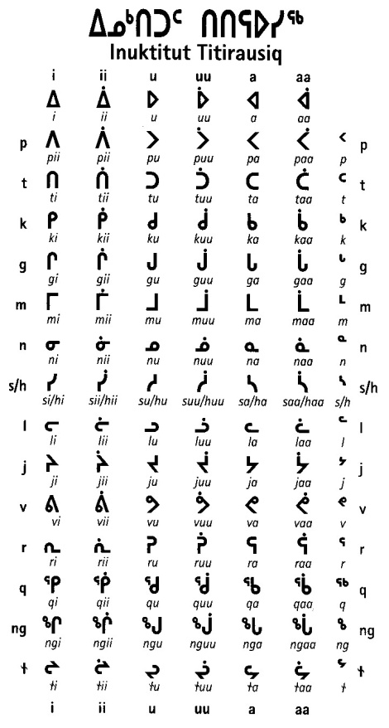
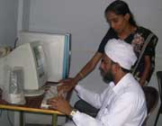
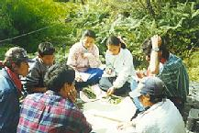
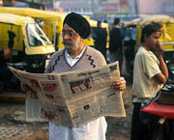
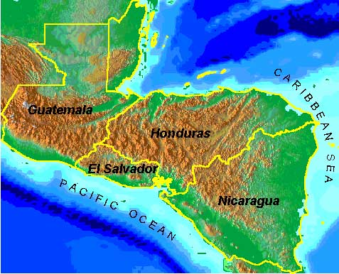
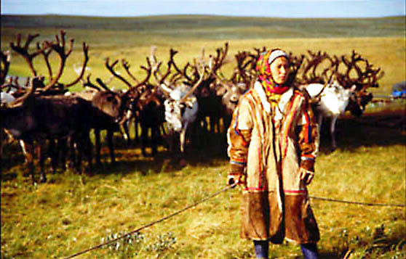
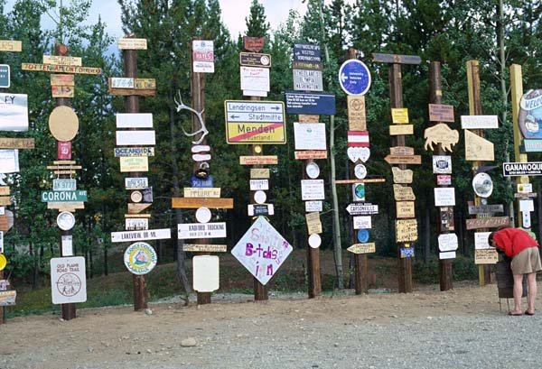
… UNGEGN working groups
Training
Data files / gazetteers
Romanization
Evaluation / implementation
Terminology
Pronunciation
Publicity / funding
Country names
Exonyms
Promotion – indigenous / minority names
Notes:
10

Slide 11
http://www.eki.ee/wgrs/

Slide 12
Romanization of Arabic

Slide 13
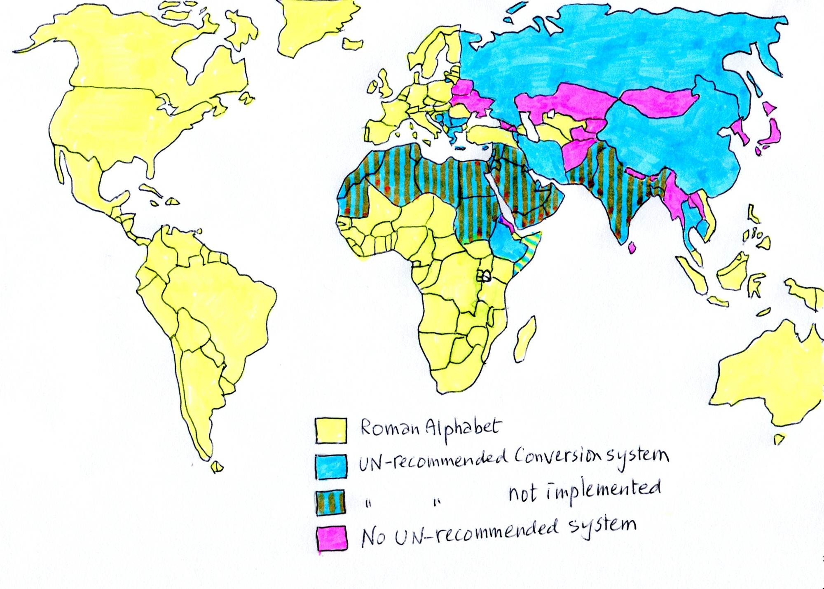
UN romanization systems
Roman alphabet
UN-recom. conversion system
UN-recomd, not implemented
No UN-recommended system

Slide 16
International toponymy training toponymy training courses
UNGEGN courses
PAIGH courses

Slide 17
Notes:
17

Slide 18
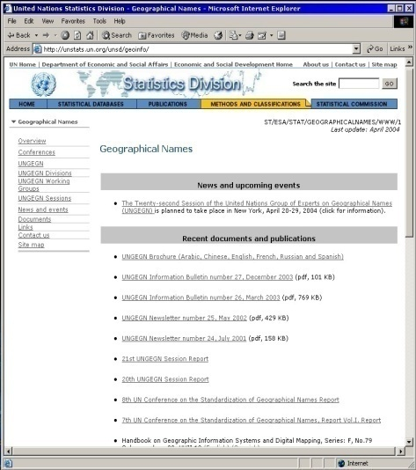
UNGEGN website . . .
unstats.un.org/unsd/geoinfo/
Overview … Mandate
Conferences
UNGEGN
Divisions
Working Groups e.g. Romanization … www.eki.ee/wgrs
Sessions
News and events
Documents and publications
Links
National names authorities; toponymic guidelines
Interactive national toponymic databases; international agencies
Contacts …

Slide 19
Notes:
19
19

Slide 20
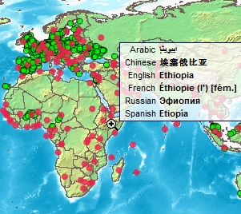
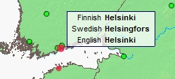
Map interface
Countries
- display six UN languages
Arabic French
Chinese Russian
English Spanish
Capital and other cities
Local name(s) - romanized
English, if available
Notes:
20
20

Slide 21
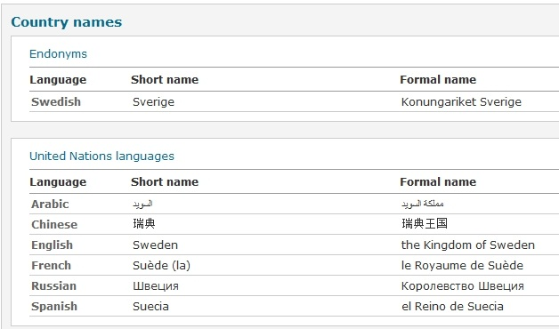
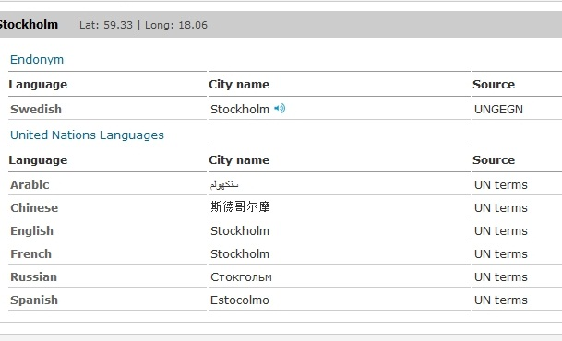
Table format – country names, cities, capitals
Endonyms … short and
formal names
UN languages … short
and formal names
Cities: short and formal names, • endonyms • UN languages • other languages
• lat. long. • language • source • sound (endonyms)
Notes:
21
Romanization system and comments to be added – Popup

Slide 22
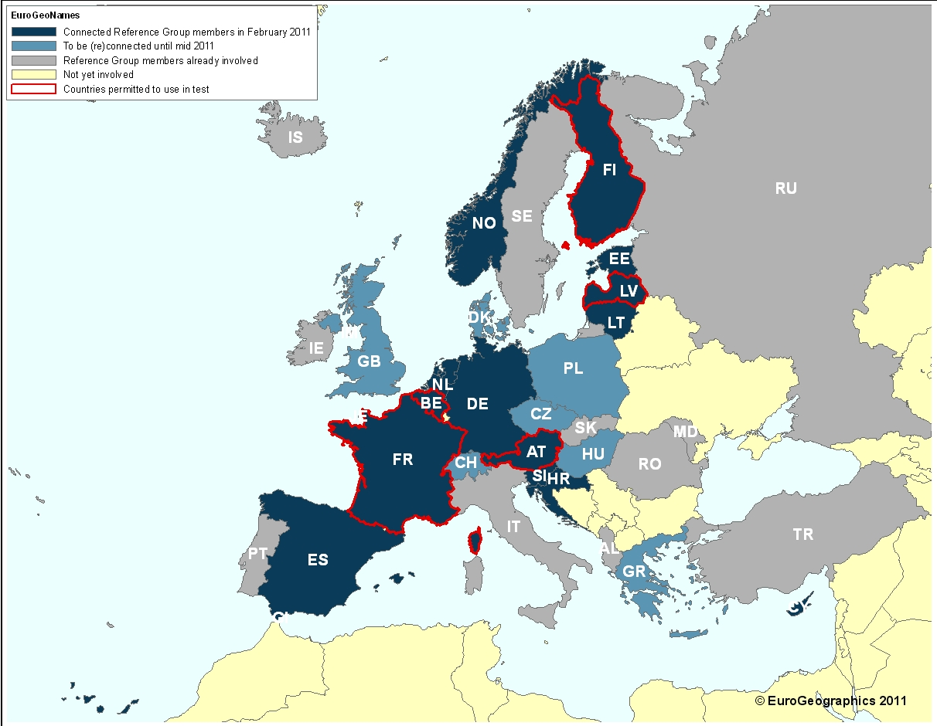
GB also connected

Slide 24
http://lazarus.elte.hu/cet/

Slide 27
27th UNGEGN session
New York …
July 30, August 12, 2012
Forum for discussion
Networking
Encouraging Africa
special presentations; posters; workshops; training
Exchange of experience; information on new initiatives
Make progress on Working Group activities

Slide 28
10th UN Conf. Stand. Geogr. Names
7.Measures taken to implement UN resolutions on stand. geographical names.
8. National standardization:
9. Geonames as culture, heritage and identity
10. Exonyms.
11. Toponymic data files and gazetteers:
12. Terminology.
13. Writing systems and Romanization:
14. Country names.
15. Toponymic education.
16. Features beyond a single sovereignty

